Slide 1
60 years of Southern Hemisphere Δ¹⁴CO₂ observed at Wellington, New Zealand
Jocelyn Turnbull, National Isotope Centre, GNS Science, New Zealand
and CIRES, University of Colorado, Boulder, USA
Sara Mikaloff Fletcher, Gordon Brailsford, Kim Currie, Rowena Moss, Kay Steinkamp, Troy Baisden, Margaret Norris, Albert Zondervan

Slide 2
Outline
The Wellington ¹⁴CO₂ record
Updates, revisions and quality checks
Long-term changes in ¹⁴CO₂
Comparison of Northern and Southern Hemisphere records

Slide 3
Where in the world?
Wellington

Slide 4
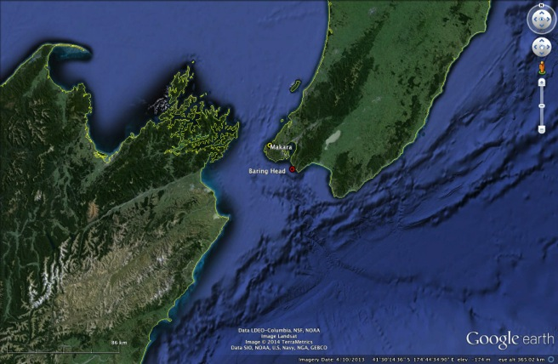
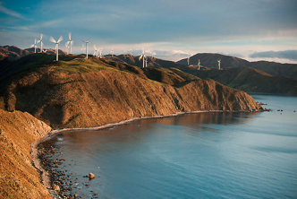
Wellington ¹⁴CO₂ record
Makara
1954-1986
Baring Head
1987-present
CO₂ sample collection by NaOH absorption, ~2 weeks continuous collection

Slide 5
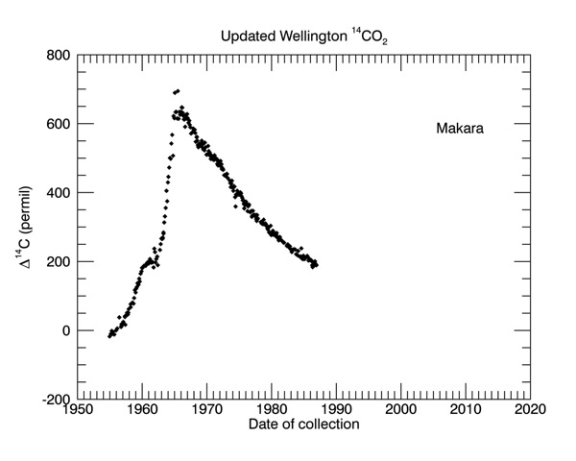
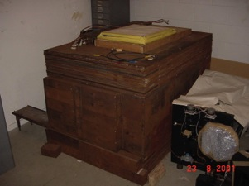
1954 – 1986 Makara sample collection - Gas counting
Revised sampling dates, decay corrections updated

Slide 6
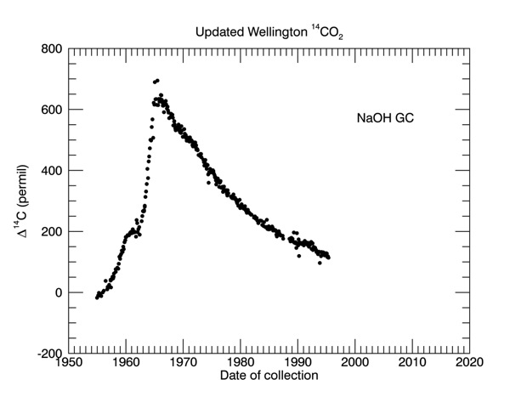
1987 – 1995 Baring Head sample collection - Gas counting
Makara
Baring Head
Noisier data through this period
“Bump” in 1990 - 1992

Slide 7
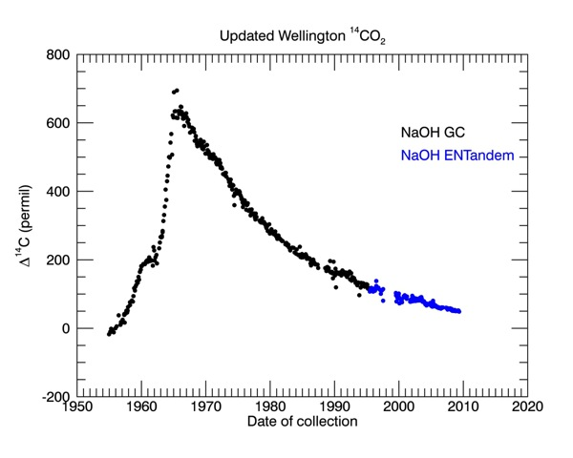
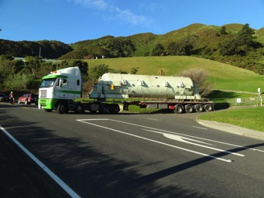
1995 - 2005 Baring Head – AMS ENTandem
4 graphite targets from each sample, averaged to a single result

Slide 8
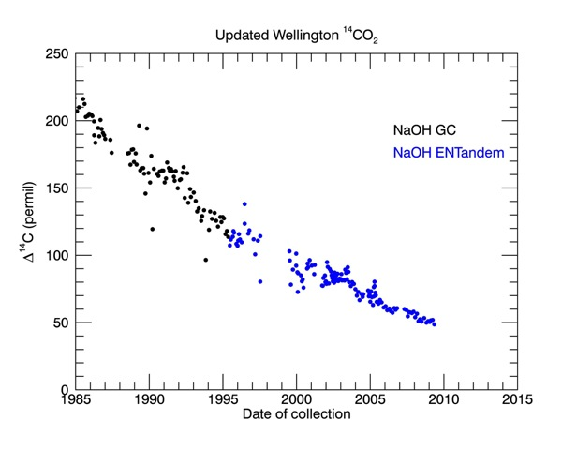
1995 – 2005 Baring Head – AMS ENTandem
4 graphite targets from each sample, averaged to a single result
Improved data quality from 2005 onwards

Slide 9
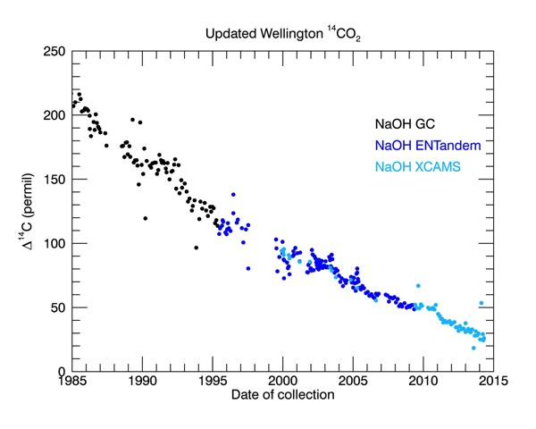
2005 – present Baring Head – XCAMS
New AMS, extended counting to ~650,000 ¹⁴C counts, single target measurement
Remeasurement of archived 2000 - 2005 samples

Slide 10
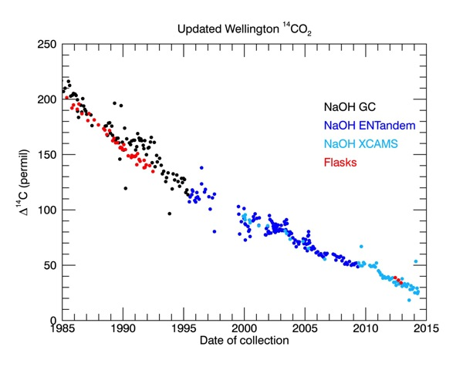
Validating the record Flask sample measurements
Whole air flasks collected in Southerly conditions
CO₂ extracted and archived until measurement in 2014

Slide 11
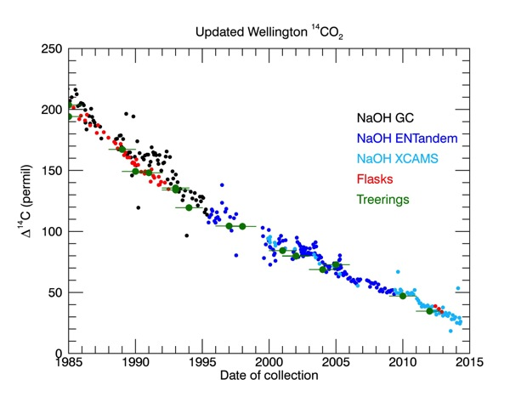
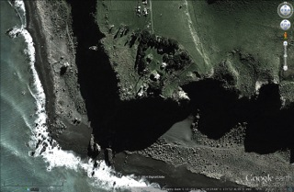
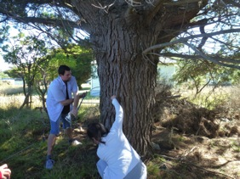
Validating the record Tree ring measurements
750m
Tree rings from Baring Head pinus radiata

Slide 12
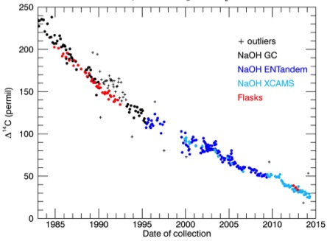
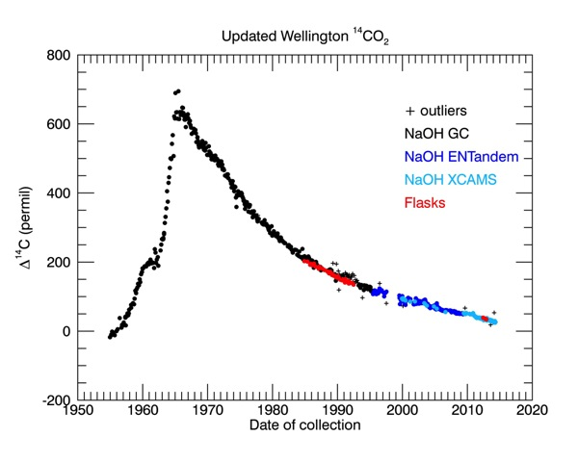
Final revised and extended Wellington record
1990-1992 “bump” and 3-sigma outliers flagged
1995-2005 “noisy” measurements still included for the moment

Slide 13
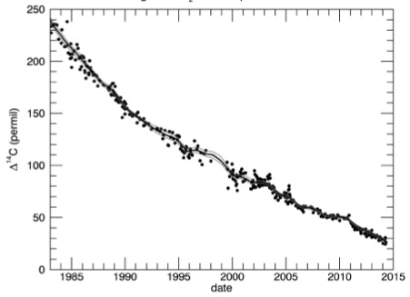
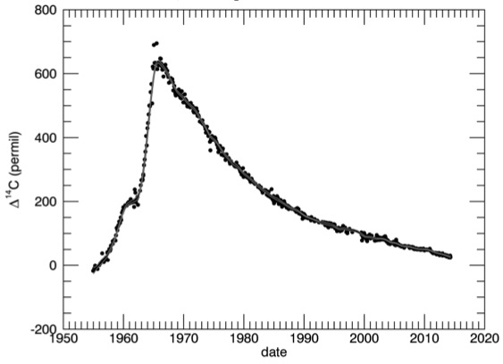
Smooth curve fit to Wellington record
Cleaned dataset available
Smoothed curve fit with 95% confidence interval also available

Slide 14
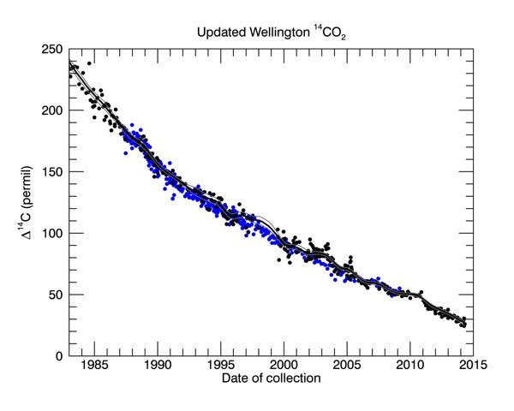
Wellington – Cape Grim comparison
Cape Grim
Wellington
Levin et al. 2010
Good agreement between Baring Head and Cape Grim records

Slide 15
What drives the Δ¹⁴CO₂ variability?

Slide 16
What drives the Δ¹⁴CO₂ variability?
“Natural” level of ¹⁴C due to balance of cosmogenic production and radioactive decay

Slide 17
What drives the Δ¹⁴CO₂ variability?
“Bomb spike”
¹⁴C produced by atmospheric nuclear weapons testing

Slide 18
What drives the Δ¹⁴CO₂ variability?
Uptake of bomb ¹⁴C into oceans and terrestrial biosphere

Slide 19
What drives the Δ¹⁴CO₂ variability?
Additions of ¹⁴C-free fossil fuel CO₂ become dominant

Slide 20
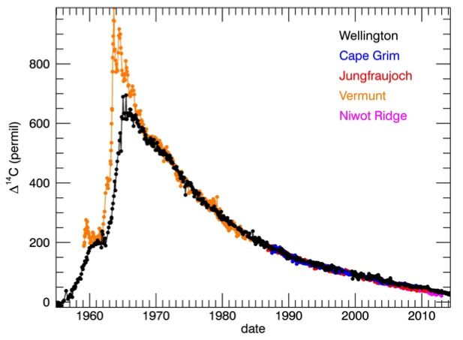
Interhemispheric Differences
Jungfraujoch
Vermunt
Niwot Ridge
Cape Grim
Wellington
Levin and Kromer 1997
Levin et al. 2010
Lehman et al 2013

Slide 21
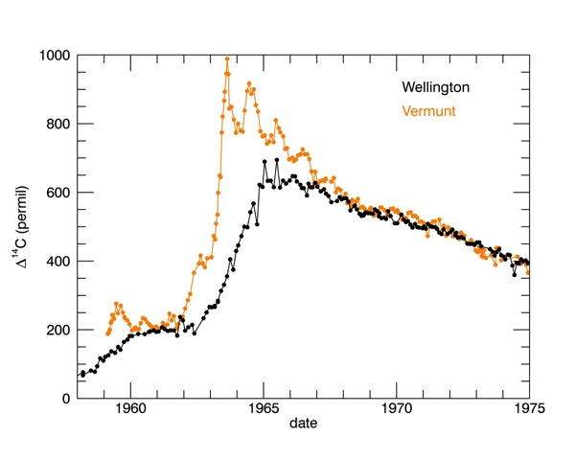
Interhemispheric Differences
Levin and Kromer 1997
Bomb ¹⁴C produced in Northern Stratosphere
Strong Northern seasonal cycle, no seasonal cycle in Southern Hemisphere
Peak occurs later and lower in Southern Hemisphere
Notes:
Seasonal cycle due to strat exchnage and seasonally varying bio uptake
Offset – interhemispheric mixing time
Decline – uptake into biosphere and oceans – trying to equilibrate the 14c content in all

Slide 22
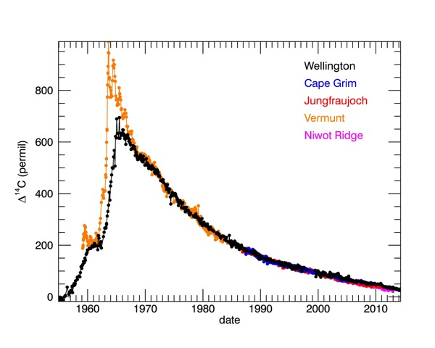
Interhemispheric Differences
Levin and Kromer 1997
Levin et al. 2010
Lehman et al 2013
1970 – 2000 not much difference between hemispheres
Notes:
1970s onwards, some differences between N and S hemispheres, but no

Slide 23
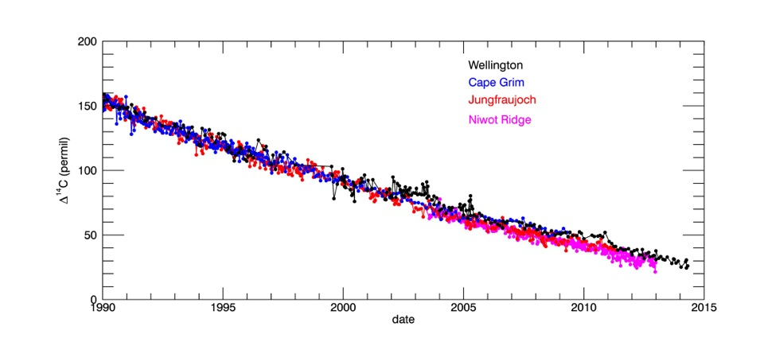
Interhemispheric Differences
Northern Hemisphere Δ¹⁴C drops below Southern Hemisphere in 2000s
additions of ¹⁴C-free fossil fuel CO₂ become dominant
Levin et al. 2010
Lehman et al. 2013

Slide 24
Conclusions
Ongoing updates and validation of Wellington record
Additional tree ring measurements 1950s – 1990s
Re-measurement of 1995 – 2005 archived NaOH samples
Ongoing sample collection and measurement
Wellington ¹⁴CO₂ record is now available on request and will be available online in the near future
Contact: j.turnbull@gns.cri.nz g.brailsford@niwa.cri.nz
Since 2000, fossil fuel CO₂ dominates the long-term trend and interhemispheric gradients
At current emission rates, Δ¹⁴C will drop below 0‰ by 2020

