Slide 1
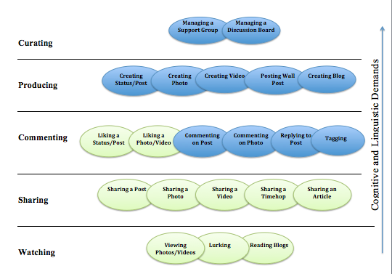
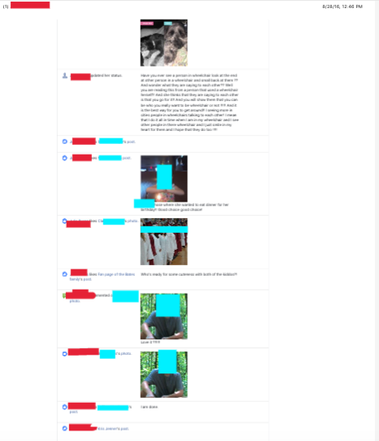
Extending communicative competence: Observations of Facebook use when using AAC
Jessica G. Caron, Ph.D., CCC-SLP, Nora Eskin, B.S., & Kelsey Farrell
Pennsylvania State University
INTRODUCTION
Social Media Engagement Framework for individuals who use AAC (Caron, 2016)
METHODS
For individuals with and without disabilities, communication environments have changed in the last five years, with increased recognition that maximizing communication participation extends well beyond face-to-face interactions (Shane, Blackstone, Vanderheiden, Williams, & DeRuyter, 2012).
The nature of social media inherently provides a context for interaction with people within a meaningful task
The literature related to social media and engagement, so far, has focused on consumer and organization interactions (Brodie, Hollebeek, Jurie, & Ilie, 2011; Hollebeek & Chen, 2014), with perspectives of engagement taken from vantage points of organizations engaging with consumers and vise-versa.
Li (2010) proposed a framework for organization and consumer engagement on social media, which included five components: (1) watching, (2) sharing, (3) commenting, (4) producing, and (5) curating. The engagement activities, proposed by Li (2010), can be applicable to use of social media by individuals who use AAC.
Design: Online observations were used to gather data across time, perspectives, and participants in the natural setting (i.e. the virtual setting of Facebook) (Patton, 2002)
Procedures: Participants shared three months of their Facebook Activity Logs
Data Analysis: An a priori coding system was established to apply the components of social media engagement framework to Facebook Activity Logs (see Figure 1 for image of Engagement Framework)
Data on one participant was isolated and examined to determine her patterns of Facebook usage. A training module will then be developed to help her increase social media behaviors to increase her number and quality of interactions on social media.
Curating behaviors include: Managing a support group or discussion board.
Producing behaviors include: Creating a status, photo, or video, or posting a wall post or blog.
Commenting behaviors include: Liking a photo, video or status, or commenting on a post or photo.
Sharing behaviors include: Sharing a post, photo, video, memory or article.
Watching behaviors include: viewing timeline, lurking, or reading content.
AIM
To date, no research has observed individuals who use AAC interact in an online environment, over an extended period of time. This study aimed to use observations to systematically analyze common behaviors individuals who use AAC and social media engage in on Facebook (e.g., liking, commenting, sharing). These findings will be used to expand current understanding for the areas in which interventions should be developed
.
RESULTS
CONCLUSIONS
A limited range of engagement behaviors are observed by individuals who use AAC.
Interventions to support and expand uses (e.g., tagging, commenting on a photo) are required in order to maximize the engagement in this communication content.
As the digital world becomes more dominant in activities of daily living and communication, the risk of exclusion rises. It is imperative that stakeholders consider ways to provide optimal access, options for engagement, and support for use of online communication contexts to ensure it is a better world for all individuals, including those who use AAC.
PARTICIPANT
Age:18
Gender: Female
Diagnosis: Cerebral Palsy
Education: Special Needs School
Access method: Direct Selection
Device: PRC 100+ iPad + iPhone
Preferred Social Media Site: Facebook
.
JB engagement on Facebook, over 3 months, demonstrates that the majority of JB’s behaviors fall under the Commenting category and Curating wasn’t observed.
JB exhibited Commenting behaviors the most. This graph breaks down the sub-skills within this category. JB utilized the “liking” function the most ( 2,803 times) in 3 months. However, she only commented on posts a total of 27 times.
FUTURE RESEARCH
Behavior observed
Investigate use of social media as therapeutic intervention for communicative access for individuals with CCN who use AAC.
Develop a training module to teach new social media skills, or access methods, to individuals who use AAC.
The first training module is designed to teach the use of the “tagging” mechanism of Facebook, and then to investigate increases in outreach for these individuals as a result of this intervention.
Behavior not observed
DISCLOSURE STATEMENT
The authors have no financial/non-financial disclosures.
JB’s observed behaviors are noted with green +’s in the context of the framework. Red –’s represent behaviors that were not observed. Overall, the highest frequency of behaviors observed require less cognitive and linguistic demands.
Follow Us/More Information
Facebook: AAC at Penn State
http://aac.psu.edu

