Slide 1
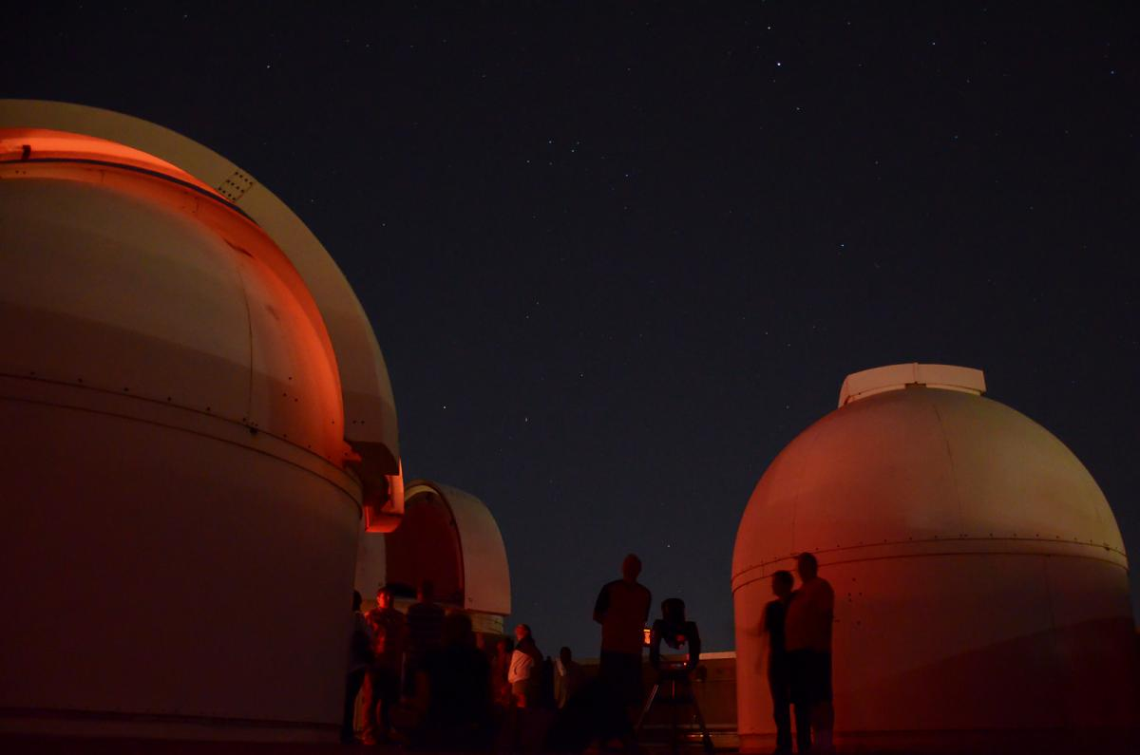

Neil A. Sharkey
New Faculty Orientation
August 17, 2017
Penn State Observatory
Notes:
1

Slide 2
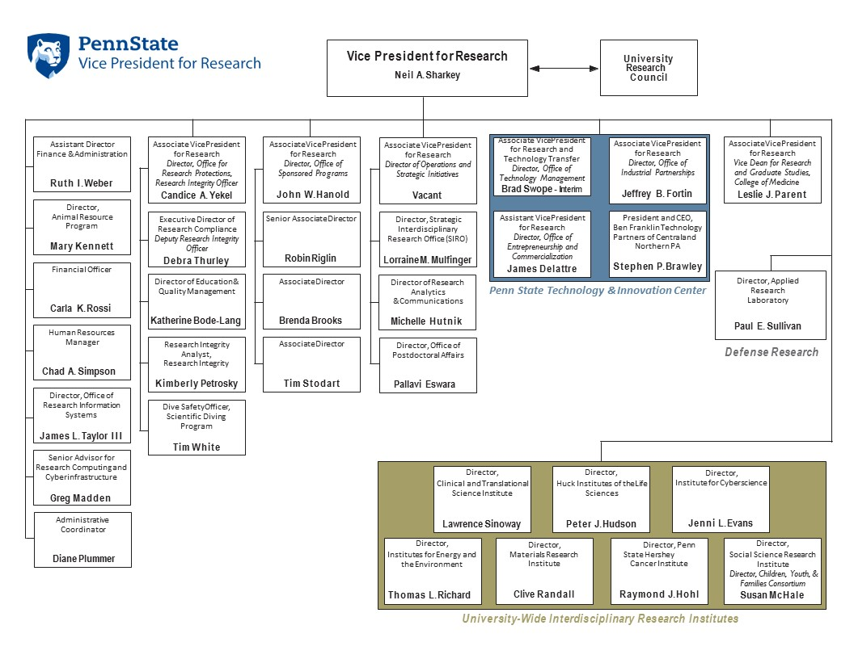

Slide 3
EDUCATION
RESEARCH
OUTREACH
Notes:
3
Penn State has a tripartite mission of teaching, research and service. These missions are integrated, each to the other.

Slide 4
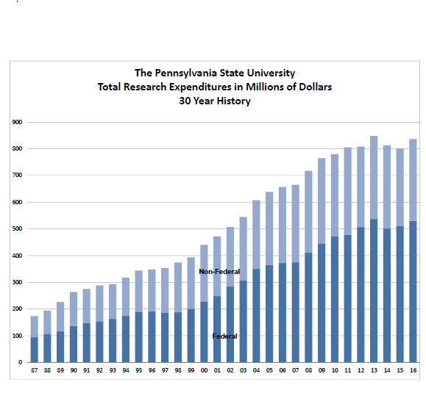

Slide 5
Institutes

Slide 6

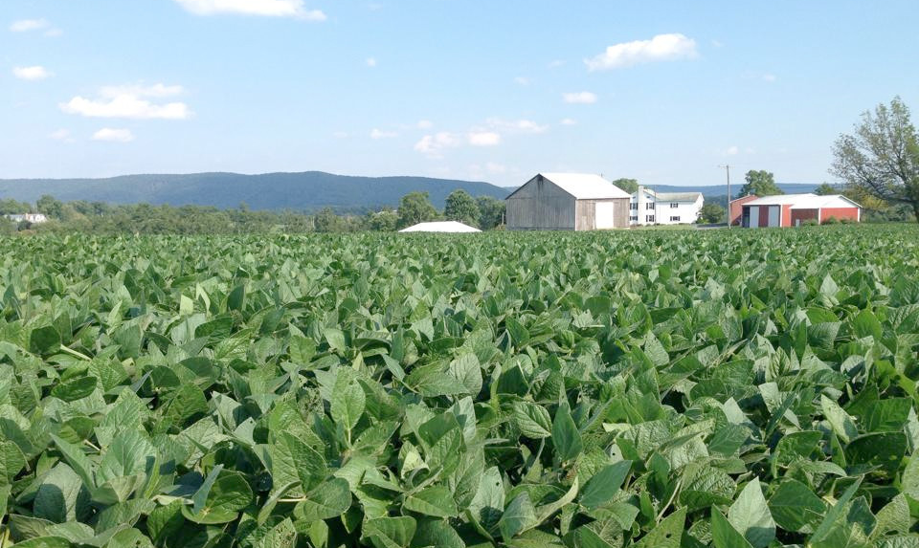
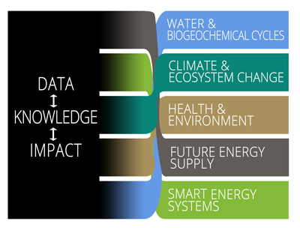
Institutes of Energy and the Environment
www.psiee.psu.edu
Notes:
6
6
Penn State Institutes of Energy and the Environment, directed by Dr. Tom Richard, embraces long term collaborations related to environmental issues and has recently initiated a major effort to further grow and enhance the vibrate energy research initiatives across campus.

Slide 7
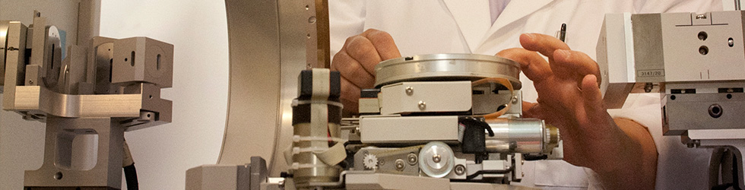

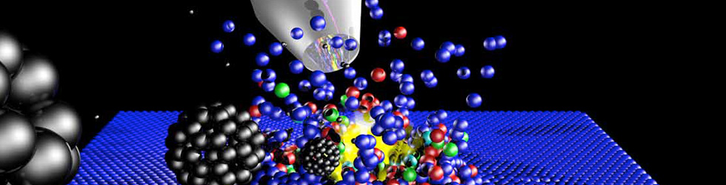
Materials Research Institute
www.mri.psu.edu
Notes:
7
The Materials Research Institute, directed by Dr. Carlo Pantano, represents one of the oldest and well established of our institutes. There are many core facilities including the materials characterization laboratory and nanofabrication facility available for the use of our faculty and students.

Slide 8
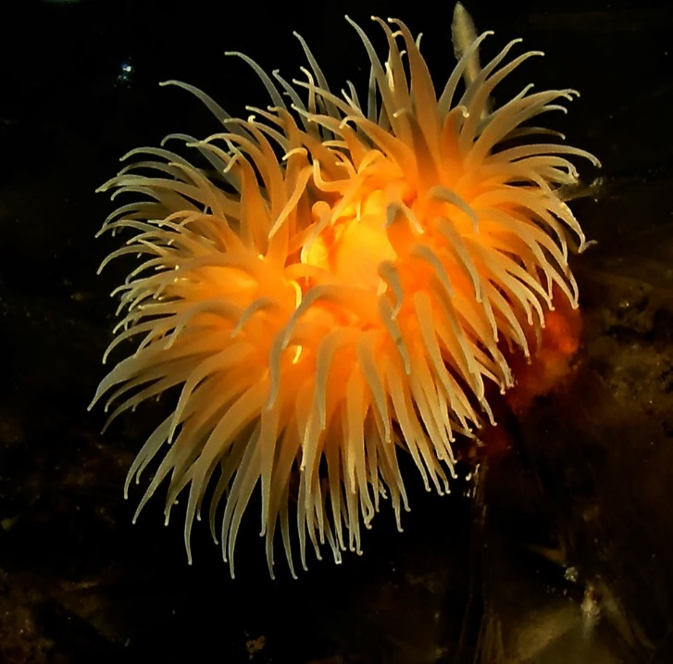
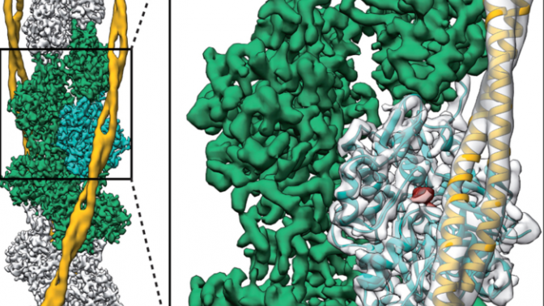
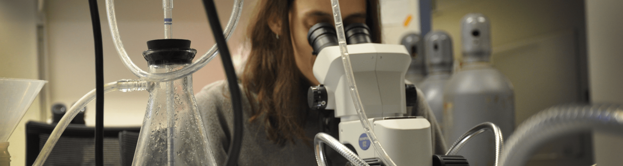
Huck Institutes of the Life Sciences
www.huck.psu.edu
Notes:
8
The Huck Institutes of the Life Sciences, directed by Dr. Peter Hudson, supports activities that span colleges and campuses with active participation from the College of Medicine. Fields of interest are widely dispersed from infectious diseases to plant biology. In addition the Huck Institutes are home to many core facilities that may be useful to some of you.

Slide 9
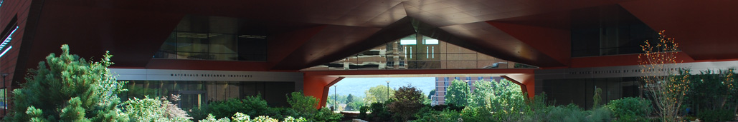
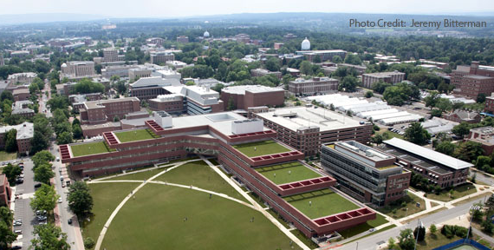
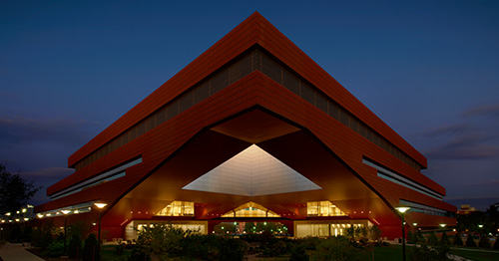
The Millennium Science Complex

Slide 10

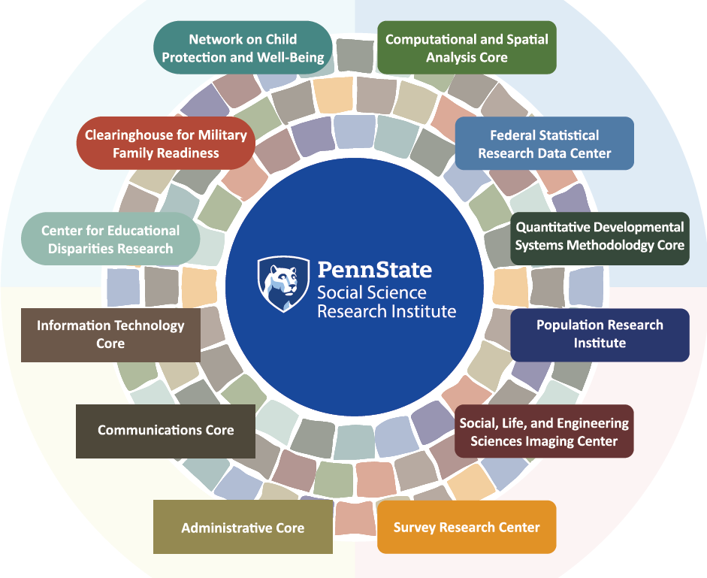

Social Science Research Institute
www.ssri.psu.edu
Notes:
10
The Social Science Research Institute, directed by Dr. Susan McHale, is home to the children, Youth and Families Consortium, the Population Research Institute and the Survey Research Center. The latter may be of use to many of you.

Slide 11
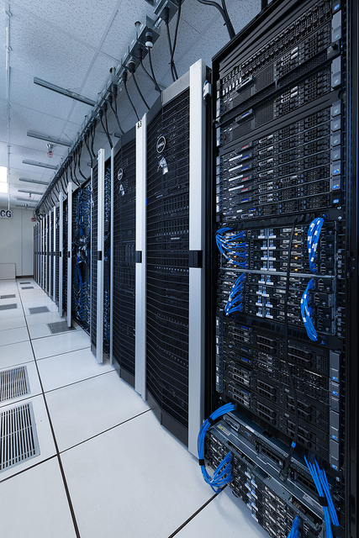

Institute for CyberScience
https://ics.psu.edu
Notes:
11
ICS is a new institute that is actually a net over the other institutes. Dr. Padma Raghavan, its director, is aggressively pursuing opportunities that bring cyberscience to faculty as a tool to solve complex problems, and as a sophisticated discipline in its own right.

Slide 12


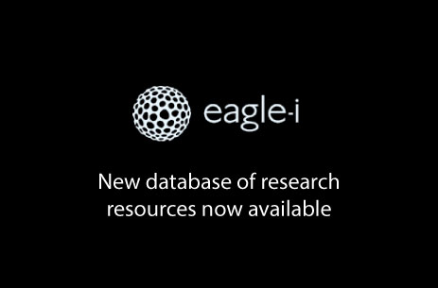
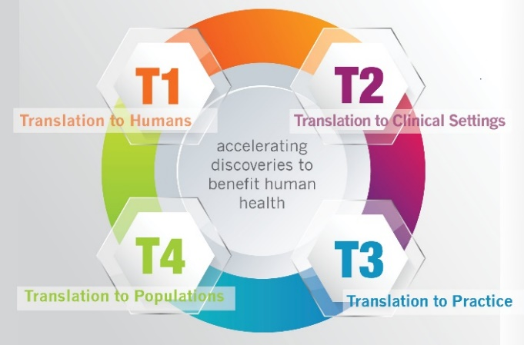

Clinical and Translational Science Institute at Hershey
http://ctsi.psu.edu
Clinical and Translational Science Institute at Hershey
Notes:
12
12
Penn State is among the best Universities nationally in terms of an environment in which to conduct interdisciplinary research. We have very few barriers. Six major cross campus initiatives are run through the research office. I will just introduce you to each of these now. In your packets you will find a web site URL and brief description of each Institute. The Institutes of the Arts and Humanities is directed by Dr. Marica Tacconi. The institute supports special initiatives for our creative faculty, promoting in particular interesting interdisciplinary initiatives.

Slide 13
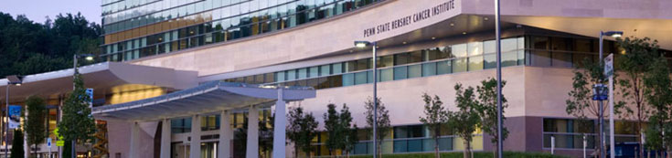
Penn State Hershey Cancer Institute
http://www.pennstatehershey.org/web/cancer/home

Slide 14
What Does It Mean to be Affiliated with an Institute?
Community of Colleagues
    Seminars
    Workshops
    Team Building for Research Initiatives
Co-Funded Appointment
Core Facilities
Seed Funds for Scholarship/Research
Notes:
14

Slide 15
Research Collaboration Fellowship
The Program was created in 2007- 08
The objectives are to encourage and build research collaborations among faculty members across Penn State and, over time, to attract external funds
This will be accomplished through summer research collaborations between faculty members from the Materials Research Institute, Penn State Institutes of Energy and the Environment, Huck Institutes of the Life Sciences, Social Science Research Institute, or the College of Medicine in Hershey
The Fellowship provides $10,000 seed money to each Fellow to cover summer living and research expenses
Details and guidelines of the program can be found: http://www.psiee.psu.edu/academic/research-collaboration-fellowship
Notes:
15
This program is being pitched to the campuses that do not have ready access to the Institutes. (note: Medicine would not be included – I wouldn’t say that unless asked. )

Slide 16


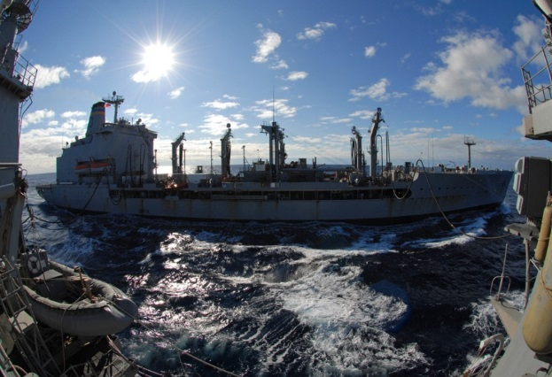
Defense-Related Research
Applied Research Laboratory
  Autonomous Control & Intelligence Systems
  Systems Engineering & Analysis
  Energy Sciences & Power Systems
  Acoustics
Electro-Optics Center
  Fiber Optics
  Laser
  Materials, Design, & Process
  Night Vision & Infrared
Education
www.arl.psu.edu
www.eoc.psu.edu
Notes:
16
Explain that DOD is one of the biggest sponsors for research at PSU because we have this special navy sponsored laboratory. The laboratory is an important place for students to gain experience, both undergraduate and graduate students. It is also a rich source of colleagues for collaborations.

Slide 17
We are here to support
your efforts!
Notes:
17
This is a reference to our office in general and an introduction to OSP

Slide 18
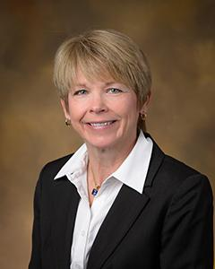
Strategic Interdisciplinary
Research Office (SIRO)
Lorraine Mulfinger
Director of Strategic Interdisciplinary Research Office
https://www.research.psu.edu/siro/
https://research.psu.edu/limitedsubs

Slide 19
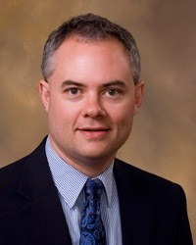
Office of Sponsored Programs
John Hanold
Associate Vice President for Research
Director, Office of Sponsored Programs
www.research.psu.edu/osp
Notes:
19

Slide 20
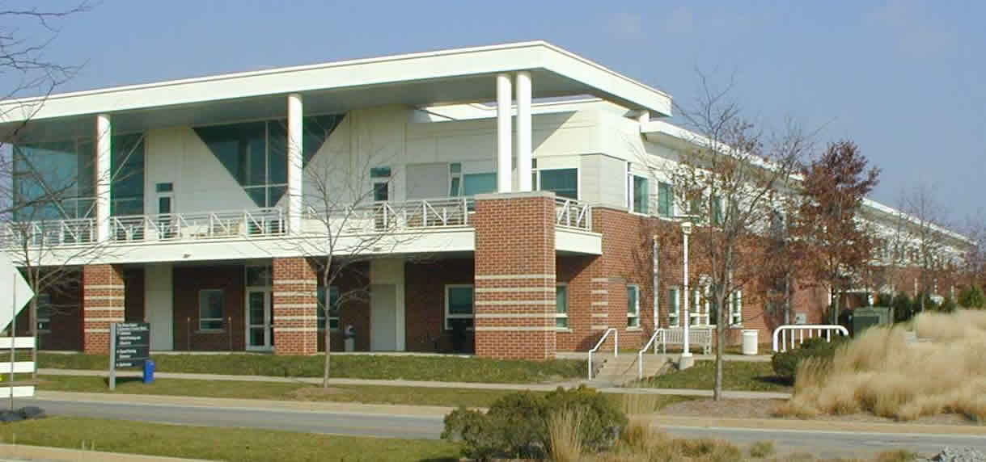
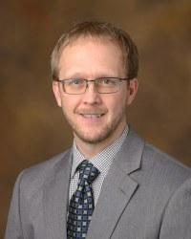
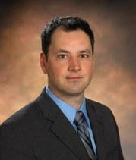
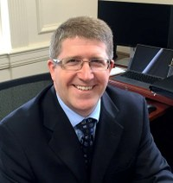
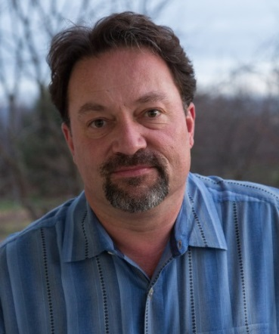
Technology & Commercialization Center
Office of Technology Management
www.research.psu.edu/otm
Office of Entrepreneurship
and Commercialization
Office of Industrial Partnerships
www.research.psu.edu/oip
Ben Franklin Technology Partners
http://cnp.benfranklin.org/
Brad Swope
Interim Director
Office of Technology Management
James Delattre
Assistant Vice President
for Research
Director, Office of Entrepreneurship and Commercialization
Jeff Fortin
Associate Vice President
for Research
Director, Office of Industrial Partnerships
Steve Brawley
President/CEO
Ben Franklin Technology Partners of Central and Northern PA
Notes:
20
Tech transfer is housed at Innovation Park on the first floor of the Technology Center.

Slide 21
Matching Funds Policy
Equipment (if required by sponsor):
  Match of 15% from central on minimum annual equipment cost of $100,000
  College/department must match at a minimum of 7.5%
          http://guru.psu.edu/policies/rag51.html
Graduate Assistantships/Traineeships (GA):
  Match equal to 50% of F&A generated on GA costs (F&A applied only to stipends, wages & fringe benefits)
  If F&A is unrecoverable, match based on 10% of total GA costs
  Minimum annual match of $10,000
  http://guru.psu.edu/policies/rag52.html
Notes:
21
I see we don’t have the urls listed here.

Slide 22
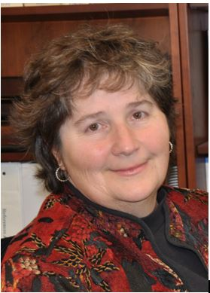
Office for Research Protections (ORP)
www.research.psu.edu/orp
Human Research Protection Program
Animal, Biosafety, and Isotope Research Protection Program
Research Misconduct Inquiries & Investigations
Conflict of Interest Program
Education Program
Quality Management Program
Scientific Diving Program
Unmanned Aerial Vehicles Program
Candice Yekel
Associate Vice President for Research
Director, Office for Research Protections
Notes:
22
We are guided by federal law and those of you who work with human subjects, animals etc. will be required to secure appropriate approvals. I am sure most of you are already familiar with IRBs, IACUC committees etc. if you work in these domains. I want to emphasize your role as “examples” for your students. None of us is born with a genetic code telling us what is proper research behavior, and what types of habits will be best to insure our behavior is good. I ask that you engage in regular conversations with your faculty and with your students about the issue surrounding research practices; everything from authorship, how it is determined and what is proper, to proper citation practices, notebook maintenance etc. Every year my office see cases of misconduct. The cases we adjudicate are usually faculty cases, but these people were once students. The habits we promote will last a life time; lets insure they are good habits.

Slide 23
Office for Research Protections (ORP)
https://www.research.psu.edu/education
Educational Program
  Scholarship and Research Integrity (SARI@PSU)
  Responsible Conduct of Research
      2 hours of discussion-based activities, plus 1 hour continuing education requirement every three years
  Campus-Wide Workshops and Brownbag Series
  ACES – ACOR Certification and Education Series
Notes:
23
To assist you we have developed a series of education tools. Beginning in fall 2009 and will be requiring that all graduate students be exposed to responsible conduct of research education, but we all know “Education begins at home.” And as I have already said as the mentors and role models, you are the ones who really reinforce these messages.

Slide 24
Office for Research Protections (ORP)
http://www.research.psu.edu/education
ORP required education and training
Offered online through the Collaborative Institutional Training Initiative (CITI)
  IRB training (for human subjects researchers)
  IACUC training (for animal users)
  SARI@PSU education for all new faculty (non-CITI options available)
Conflict of Interest Training (as part of Annual Financial Disclosure process in COINS)
Notes:
24
To assist you we have developed a series of education tools. Beginning in fall 2009 and will be requiring that all graduate students be exposed to responsible conduct of research education, but we all know “Education begins at home.” And as I have already said as the mentors and role models, you are the ones who really reinforce these messages.
In 2011, SARI@PSU was expanded to include new faulty, postdoctoral fellows, and undergraduate researchers.

Slide 25
Significant Financial Interests (“SFI”)
Investigators are required to disclose personal financial interests that are related to his/her institutional responsibilities
Disclosure triggers - at least annually, within 30 days of discovering or acquiring a new SFI and prior to the submission of research proposals that are related to the SFI (e.g., the entity sponsoring or providing cost-share in the proposed research or that makes a product being tested in the study)
If the COI Committee determines that there is a potential or perceived conflict between the disclosed SFI and any Penn State research, then it will work with the investigator to reduce or eliminate the conflict PRIOR to any award funds being released
See: RP06 (http://guru.psu.edu/policies/RP06.html)
Notes:
25
Conflict of interest is a problem of life. It cannot also be avoided but can usually be managed. The university encourages faculty to develop intellectual property and as such COI will happen. But if you disclose up front, talk with your department head, plans can be develop that do not prevent you from being involved in such activities. Similarly consulting is permitted but we all must remember that our primary commitment is to the University and its students. Consulting can be a very good thing; it helps with economic development, sharpens our skills, creates contacts that can help research and help our students; it is not a bad thing but must be handled well.

Slide 26
Outside Professional Commitments
Outside, private professional activities cannot exceed 40 hours per month.
Special care should be exercised in executing private consulting contracts or arrangements. For example:
  contracts should be examined to ensure that the assignment of rights to intellectual property evolving from consulting activities does not conflict with the patent agreement signed by all faculty; and
  any associated compensation will likely require a financial disclosure by the faculty involved
See: HR80 (http://guru.psu.edu/policies/OHR/hr80.html)
AD77 (https://guru.psu.edu/policies/AD77.html)
Notes:
Faculty are encouraged to engage in outside activities when such activities enhance the mission of the University and do not compete with the University.

Slide 27
Data Management and Integrity
Researchers are responsible for:
Ensuring the integrity of their data
  Ensuring that the data from published papers are publically accessible
Properly archiving data

Slide 28
myResearch Portal www.myresearch.psu.edu
Provides investigators an integrated view of sponsored portfolio data
Simple tools to support the PI
  Current and Pending report
  Export financial data to Excel
Accessible anytime, anywhere
Simple to use, always evolving
Login via the WebAccess application, which requires two-factor authentication via either the Duo application or the Vasco SecureID token

Slide 29
