Slide 1
I’m Okay To Play
The Dangers That Concussions Pose To Today’s Youth
By: Connor Grabowski

Slide 2
The problem
Concussions among youth continue to grow and plague our young athletes.
Approximately 1% of the US population suffers a concussion every year (3.8 million).
Athletes and young people do not feel a sense of urgency to report them properly.
About 50% of concussions go unreported or untreated (NY Times).

Slide 3
My Advocacy Project
Spread awareness to young athletes about the dangers of concussions and the proper steps to take to report them.
I visited Holy Ghost Prep’s Varsity Baseball team and gave a presentation at practice.
Topics included:
Statistics about concussions
Worst-case scenarios
Informing audience of precautions and steps to take towards safety
Polling of audience about past experience with concussions
Answering questions the audience may have had

Slide 4
My Goal
A goal of 0 concussions this season is unrealistic as concussions are a natural outcome of athletes playing hard and wanting to win.
A realistic goal for this is that none of the athletes I presented too fail to report concussions or feel lasting effects of them.
I plan on attending their game on May 6th and giving another short talk about how they now feel about concussions and its relationship with the game of baseball.

Slide 5
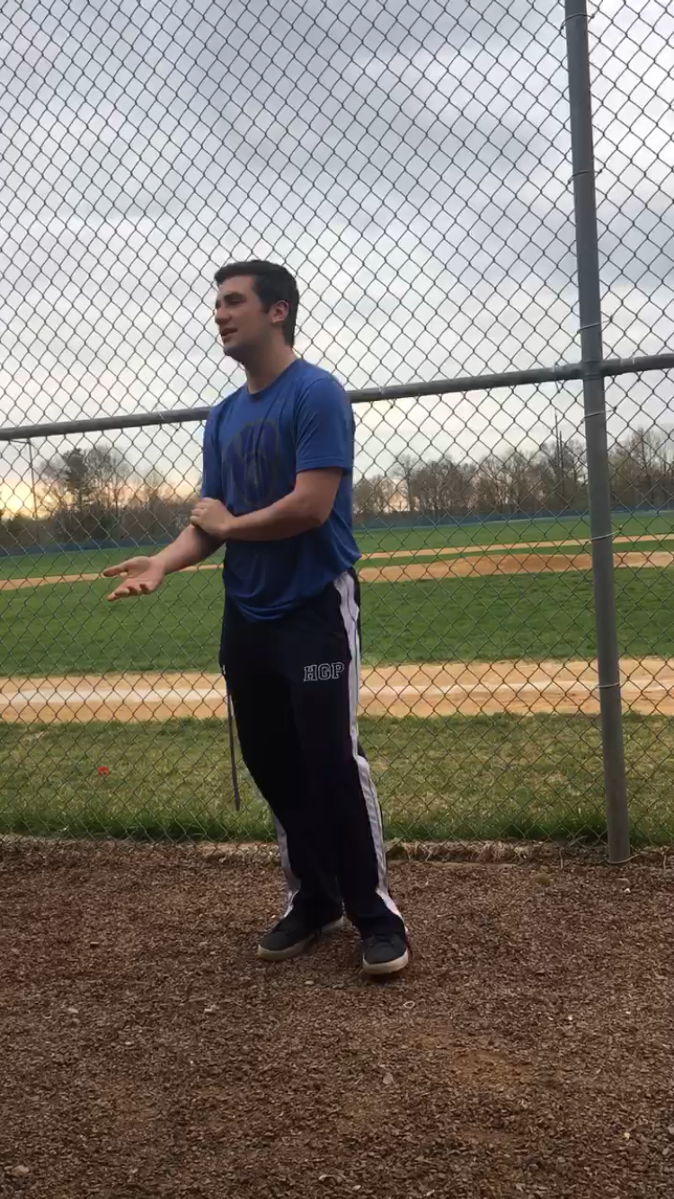
Rhetorical Choices
Modes of persuasion
Ethos
Logos
Pathos
Kairos
Language (formal vs. casual)

Slide 6
