Slide 1
Thinking about & with media technologies
Dr. Zack Furness Penn State Greater Allegheny

Slide 2
What is technology?
Communication scholar, Jonathan Sterne, rightly describes technology as a constellation of:
Tools, Containers, Devices*
Practices, Ways of Doing Things, Techniques
Ideas, Beliefs, Experiences
Institutions, Traditions
*including the human body

Slide 3
Not what we’re used to hearing
Sterne’s robust definition is an important one for how it challenges the typical ways in which we are taught (via popular culture and also in many scholarly works) to think about, discuss, and debate technology.
More often than not, our views of technology are overly simplistic and they tend to ignore a lot of what is significant about their histories, uses, possibilities, and limitations.

Slide 4
How not to think about technology: 1. Technological determinism

Slide 5
Technology does things (To Us)
One of the biggest hurdles to having productive conversations about technology stems from the common sense ideas we tend to hold about the way technology works and the role it plays in our society.
Much of what we hear about technology – in news stories, popular magazines, films and online discussions – falls under the umbrella of what scholars call technological determinism, which is to say, a perspective that views technology as the thing that drives social change and basically determines how we live.
Thinking in this way is problematic because it transforms the complex relationships between humans and technologies into a simple matter of cause and effect: technologies cause things to happen (they are active) and people are simply affected by them (we are passive). Unfortunately, this is the dominant lens through which we tend to view media technologies in both the past and the present.
We hear it all the time through pronouncements like these…

Slide 6
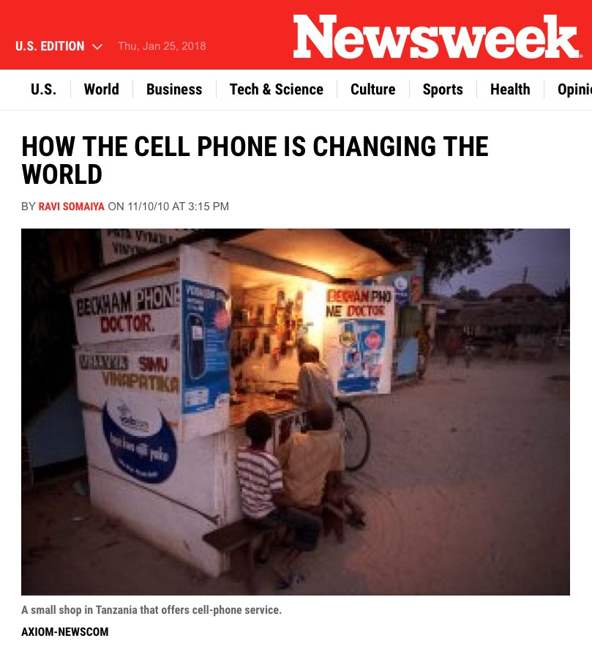
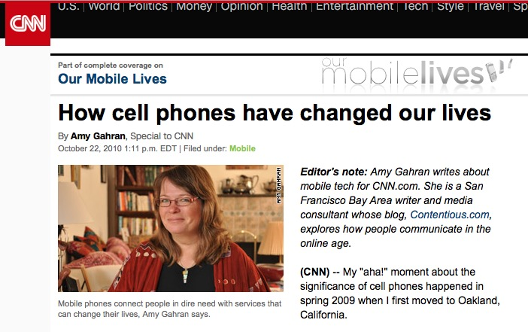

Slide 7
Technological Determinism (Cont.)
Jonathan Sterne points to some other everyday examples of technological determinism at work:
Google makes us stupid
New innovations will fix higher education
Alternative energies can fix climate change
There is, of course, a kernel of truth to such claims. Cars, for example, affect the way that pedestrians and cyclists use city streets, even when they are parked.
However…
This doesn’t change the fact that technological determinism is a sloppy way of thinking. A better, and more accurate analysis of technology is one that acknowledges how social forces, economic conditions, political attitudes, and cultural norms are ultimately responsible for how and why technologies are invented, innovated, and used.

Slide 8
How not to think about technology: 2. The ‘Great Inventor’ story

Slide 9
There once was a man…
The Great Inventor Story, Version #1: The history of technology is comprised of individual geniuses who invented new things on their own
On rare occasions, yes. But…
Inventors almost never work alone. Research is normally done in teams.
Large groups have often been responsible for tech inventions and innovations. Example: GNU operating system emerges from computer geek/hacker subculture.
New technologies are often commissioned, as opposed to being the product of one’s raw imagination or the result of a vision one has after bumping one’s head.
Research & development (R & D) is the typical model for how new technologies are designed and built. And they are usually invented to fill an existing market. Example: corporations creating new weapons for the military.
Most R&D is undertaken by groups who do not own rights to their ideas (therefore we don’t know many of their individual stories).

Slide 10
There will be a man…
The Great Inventor Story, Version #2: The future will be forged by individual geniuses who will do with technology what has never been done before
Perhaps. But…
That probably won’t happen.
Because that’s not the way things happen.
Regardless of what Forbes magazine says.

Slide 11
R&D: How it really happens
The Systematization Of Technological Research
In the latter half of the 19th Century, Western Union funds a boom in technological research and hires people like Thomas Edison and Alexander Graham Bell to create things.
Following their work at Western Union, both Edison and Bell found their own laboratories and begin funding new experiments and research that leads to the development of commercially viable technologies (such as the phonograph)
This model of institutionally funded scientific research proved very influential and became standard practice for companies interested in developing new technologies for the market in the 20th Century.

Slide 12
How not to think about technology: 3. markets appear naturally

Slide 13
If you build it, they may not come (and they might use it differently)
Faulty Assumption: The market for new technologies appears naturally
On rare occasions, yes. But…
Markets typically have to be created.
People need to be persuaded as consumers – they don’t automatically desire new technologies simply because they exist.
Example: The first home computers
Faulty Assumption: Uses are invented along with the technology
On rare occasions, yes. But…
More often than not, uses are created by people who are not involved in developing specific technologies.
Example: Turntables used in hip hop

Slide 14
How not to think about technology: 4. evolutionary theory

Slide 15
Evolutionary Theory of Tech History
A great deal of theorizing about technology relies on an explicit or tacit belief in an evolutionary theory of technology. Simply put, it’s the idea that technologies endure because they are the best. It has several interrelated premises:
Survival of the fittest (superior tech displace inferior tech)
Many examples would prove otherwise. For instance, people have predicted the demise of print for well over 500 years - initially, because it was seen as inferior to oral communication and, nowadays, because it’s seen as inferior to digital.
Sometimes economic competition suppresses the better technology, often for reasons that have nothing to do with the technology itself.
Example: Betamax versus VHS. Betamax had a better picture and sound (at the time) but the tapes were only 1.5 hours long. This proved to be a huge marketing blunder because you needed more than one tape to watch a typical movie. The booming video rental industry stopped carrying them in favor of 2-hr VHS tapes.
Also, many new technologies appear because of invented necessity (such as email or cell phones).

Slide 16
Evolutionary Theory of Tech (Cont.)
“The best of all possible worlds”
In a nutshell, this is belief that our current use of technologies allows us to create the best world that’s possible.
However, there are many social and contextual factors that mitigate against technology realizing its potential. For instance, existing technologies could be used to remedy world hunger and eliminate poverty, but this doesn’t happen for ideological reasons (such actions are “communist” and therefore deemed bad, antithetical to capitalism, etc.).
Triumphalism (the idea of inevitability)
This is the notion that there is a natural, inevitable progression of technology throughout human history that cannot be stopped.
This implies that newer technologies are inherently better than old ones. But there are plenty of things that we sacrifice for newness, such as compatibility with other technologies we use or being subject to planned obsolescence in newer designs.
Example: Eliminating the headphone jack in the newest iPhones.
Also, sometimes we go back to using “old” technologies because we realize they are actually better (in terms of quality, ease of use, cost) than ones that once replaced them.
Example: Vinyl record sales hit a 25-year high in 2017 and cassette sales grew by 74% in 2016, whereas CDs – once heralded as the superior format – are now almost obsolete.

Slide 17
Why inventions fail (it’s not ‘evolution’)
Example: The Picturephone (not to be confused with Beyoncé’s Video Phone)
AT&T debuted it at the 1964 New York World’s Fair and marketed it unsuccessfully in the 60s and 70s even though it worked and seemed like a clear ‘evolution’ from the standard telephone.
So, why did it fail? Because:
Lots of people have to own them to communicate.
Very expensive equipment and monthly bills.
People often don’t want to be seen when they’re on the phone (for example).
THE MORALS TO THIS STORY:
1. Newer isn’t always better.
2. Technology doesn’t always progress in a straight line.

Slide 18
Communication (Technologies) as culture

Slide 19
Getting beyond inventors & ‘fitness’
In contrast to a number of the trends described thus far, there is a rich body of scholarship that demonstrates how one can study media and communication technologies in an appropriate historical, political and cultural context.
In addition to essays and books cited in the sections above, this week’s reading on early radio listening provides an excellent example, inasmuch as the author, Richard Butsch, explores listening as a cultural practice that’s informed by:
gender dynamics (who listeners are)
technical knowledge (what listeners know)
shifting ideas about public and private spaces (where listeners listen)
various kinds of media representation that help to define the role of the audience (what listeners do) and the act of listening itself (what it means)
Susan Douglas’s work is another stellar example of cultural analysis that offers a complex account of radio’s history that moves beyond ‘great inventor’ narratives of it’s origins. Radio, as Douglas shows in her book Inventing American Broadcasting, wasn’t simply an invention brought into the world like a fully formed baby. Rather, it was developed from the work of a number of different groups and institutions, including the US military, corporations, entrepreneurs, universities and hobbyists (all of which, incidentally, are similarly responsible for the development of the Internet decades later).

Slide 20
Forces that shaped the development of radio (1890s – 1920s)
Notes adapted from Susan Douglas, Inventing American Broadcasting

Slide 21
The Military
Was interested in finding ways to transmit messages without wires, particularly for the Navy.
Particularly interested in utilizing wires transmissions for sending coded messages (secret communication) to link ships and coordinate actions.
For more about the Navy’s use of radio around the turn of the 20th Century, see chapter four in Susan J. Douglas, Inventing American Broadcasting 1899-1922 (Johns Hopkins Press, 1987), 102-143.

Slide 22
Corporate sector
Aside from the early radio companies owned by inventors like Marconi, the corporate sector didn’t know what to do with radio at first.
Western Union started funding experimental communication without wires, i.e. wireless telegraphy.
Eventually, many get into the business making radio equipment/hardware and in the 1910s corporations begin to exert a great degree of control over radio manufacturing, broadcasting, and policy-making. For more about this, see chapter eight in Susan J. Douglas, Inventing American Broadcasting 1899-1922 (Johns Hopkins Press, 1987), 240-291.
By 1915, over 20 companies were selling point-to-point radio equipment:
AT&T (transmitters)
General electric (receivers)
American Marconi (both)

Slide 23
EDUCATIONAL SECTOR
Universities housed many academics who were early experimenters in radio and broadcasting.
They were also the first places to have certified broadcasting, as well as the first to have public radio facilities available to the community.

Slide 24
PRIVATE HOBBYISTS
This group of tinkerers was largely comprised of middle-class men, many of whom were ex-military who learned how to build and use radios during their time in the service.
Helped to popularize radio as an amateur activity and many also pushed new boundaries for radio technologies and broadcasting techniques.
For more about this community of amateur radio operations, check out the prologue to Kristen Haring’s book, Ham Radio’s Technical Culture (Cambridge, MA: The MIT Press, 2006).

Slide 25
ENTREPRENEURS
As the corporate sector begins to sell equipment to the public, others being to use these technologies to create new businesses and expand into different markets.
This group comes up with new ideas for how to use content as a way to get people to listen.
Examples:
Broadcasting live sports – the first boxing match aired in 1921.
Selling airtime to advertisers – the first commercial was aired on WEAF in 1922.

