Slide 1
Friday November 16, 2018: MAFS Agenda
ADVISING SURVEY -- Mike
LAUNCH OF PR & MARKETING HELPDESK -- Staci
UNIVERSITY FACULTY SENATOR’S
COMMITTEE REPORTS
IT
Faculty Affairs
Academic Festival Committee
CAMPUS ACTIVITY REMINDERS:
November 28th Advice & a Slice: STEM Edition -- Kim
Holiday Party -- Linghao
OPEN
ADJOURNMENT
Next MAFS Meeting: Wed. 12/5/18

Slide 2
PSMA Advising Feedback Form
https://sites.psu.edu/montaltoadvising/

Slide 3
The adviser was easily accessible.
I met with this adviser this many times this semester:
NEVER. 1 TIME. 2 TIMES. 3 TIMES. 4 TIMES. 5 OR MORE TIMES
I received accurate information about my academics and about Penn State policies from this adviser.
If this adviser is unsure of an answer to one of my questions, he/she will get back to me with the correct answer, or refer me to another office for help.
This adviser shows concern for my academic success.
I feel comfortable and at ease with this adviser.
Overall, I am satisfied with this adviser.
Please include comments and feedback about your advising experience this semester. We'd love to know what might have improved your academic advising experience.

Slide 4
b 14th Annual Academic Festival a
When: (week 13)
Timing:
Proposals:
Keep in mind:
The AF is like a Science Fair, but for all disciplines:
Research Posters, Informational Exhibits, Art Show,
Oral Presentations and Performances
Please encourage your students to participate!
Fall projects? Add to Spring syllabi?
We have $1,000 for prizes; looking for more…
We will eventually need many volunteer judges
Consider inviting local contacts to attend and/or judge
Questions? Contact Kim Herrmann &/or Patty Gochenauer
Stay tuned for more information!
Friday, April 12th
noonish to 4ish
Now – Fri., March 15th
(Friday after Spring Break)

Slide 5
4 Panelists: Past PSMA students! (2012-2014)

Slide 6
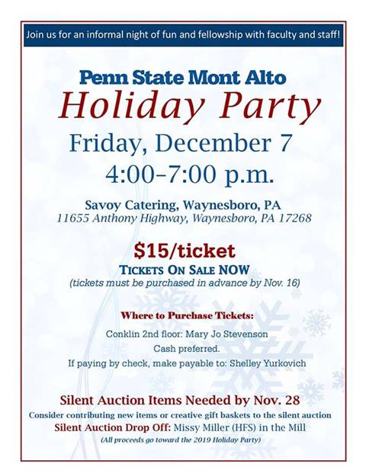

Slide 7
Friday November 16, 2018: MAFS Agenda
ADVISING SURVEY -- Mike
LAUNCH OF PR & MARKETING HELPDESK -- Staci
UNIVERSITY FACULTY SENATOR’S
COMMITTEE REPORTS
IT
Faculty Affairs
Academic Festival Committee
CAMPUS ACTIVITY REMINDERS:
November 28th Advice & a Slice: STEM Edition -- Kim
Holiday Party -- Linghao
OPEN
ADJOURNMENT
Next MAFS Meeting: Wed. 12/5/18

