Slide 1
(Gender) diversity may be optimal for teams, but are teams optimal for diversity (women)?
Aparna Joshi, Ph.D.
NSF Workshop on Work Climate
Penn State, May, 2016

Slide 2
Is Diversity Optimal for Teams?
The Diversity-Performance Relationship:
60% of effects reported in past research were non-significant
20% of the effects significantly positive
20% of the effects significantly negative
What is going on??
Faultlines (Lau & Murhighan, 1998)
Conceptualization (Harrison & Klein, 2007)
Context – Industry/Occupation
(Joshi & Roh, Academy of Management Journal , 2009, Meta-analysis – 4 decades of diversity research)
2
Notes:
2
As a researcher interested in studying diversity issues in the workplace how would you reconcile these mixed and contradictory findings across these three studies? What additional questions would you have?

Slide 3
The Role of Context in Work Team Diversity Research (Joshi & Roh, 2009, AMJ)
Notes:
When I started out – naïve notion

Slide 4
Since 2009 focused on multidisciplinary S&E teams
(NSF grant)
Teams are an important focus in this context
Units of scientific innovation
But to be optimal as units of innovation- inclusive team environments are essential
Innovation = fn (Inclusion)

Slide 5
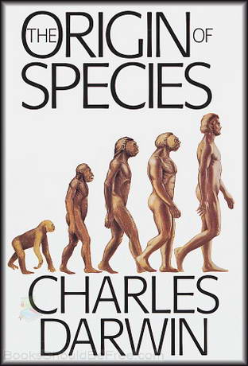

Slide 6
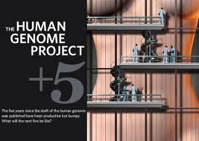
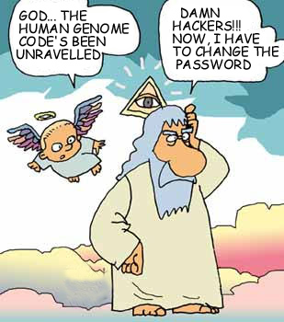

Slide 7
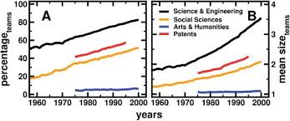
Teams Dominate Science
Based on an analysis of 20 million papers published across major disciplines research shows that the production of knowledge over the past 5 decades is increasingly team based
Wuchty et al., 2007

Slide 8
But what type of a context is it for women?
Women less than 10% of all engineering managers
Since 2000 in S&E: Bachelor’s degrees - women > men
Master’s degrees -
50/50
Male to female faculty ratio in S& E Depts:
2.5 to 1.
Female scientists paid on average 75 % relative to male
scientists

Slide 9
“Throughout my twenty-year career, I have put together many research groups…brought together physicists, electrical engineers, biologists… always I do my best to bring together people who are the most competent and skilled – the brightest of them…yet I find that the dynamic that unfolds in my group is difficult to predict before hand…sometimes a group can be amazingly productive and sometimes things just come apart even with the best people…What predicts the success of my team? I wish I knew the answer to that question .”
Interview excerpt, Bio-Photonics Laboratory Leader

Slide 10
My Argument
The lab leader’s dilemma is essentially a ‘diversity’ problem:
Recognizing expertise is a challenge in teams
Hidden profiles
And teams are not that egalitarian…
Interactions can reinforce gendered hierarchies

Slide 11
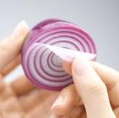
There are many ‘layers’ to gender in teams

Slide 12
Unpacking the Layers
By whom and when in women’s expertise recognized? (Administrative Science Quarterly, 2014)
Three studies across 60 teams, >500 scientists and engineers
Dyadic expertise evaluations as ‘bottom up’ processes
Unpack expertise evaluations from two perspectives:
Target (social role theory)
Actor (social categorization theory)

Slide 13
Unpacking Expertise Recognition
Targets (Social Role Theory):
Atypical targets are penalized == women are rated lower
Actors(Soc Id Theory):
Ingroup/Outgroup categorization == women are rated lower
Male Scientist
Female Scientist

Slide 14
Unpacking Expertise Recognition
Targets (Social Role Theory):
Atypical targets are penalized == women are rated lower
Actors (Social Identity Theory):
Ingroup/Outgroup categorization == women are rated lower
Does educational attainment help women overcome these challenges?

Slide 15
Measures
Sex: 1=Female
Educational status: continuous measure, years post high school
Across three studies = 55 teams, 500 scientists/enggs
15 disciplines, faculty composition from univ archives
Expertise perceptions: “This person has the expertise to make valuable research contributions to the lab” (each lab member listed)
Expertise utilization: For each individual: Num of pubs, conf papers etc/ size of the lab (12-16 months after initial surveys)
Research productivity of lab: Lab level pubs, patents, conf papers(12-16 months after initial surveys)
Social Relations Modeling: Actors = Raters ; Targets = Ratees

Slide 16
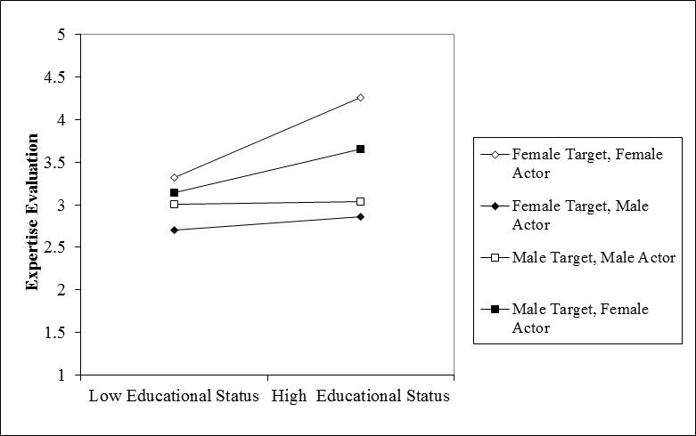
By whom is expertise recognized?
Women differentiate based on Educational level
Men differentiate based on Gender

Slide 17
By whom is expertise recognized?
Men who are highly identified with their gender rate highly educated women lower than less educated women

Slide 18
When can gender diverse teams maximize productivity?
Gender diverse research teams are more productive when faculty is gender integrated

Slide 19
Going back to the lab leader’s dilemma…
Gender is likely to serve as an important “expertise signal” in the lab
But remember that women bring value to the team by making expertise attributions based on relevant cues
Gender is not just about women, its about men and women – we need to bring both men and women into this conversation
Men vary in their attitudes towards women and those variations matter
Successful female scientists or leaders are not just role models for women but also for men
The overall context of the discipline also matters
Training interventions can be targeted more specifically to specific domains

Slide 20
Conclusion
For teams to benefit from gender diversity it is important that women benefit from working in teams
Optimizing teams ➔ inclusive work environments
Innovation = fn (Inclusion)

