Slide 1
Anthropocene
Time for a New Geologic Epoch?

Slide 2
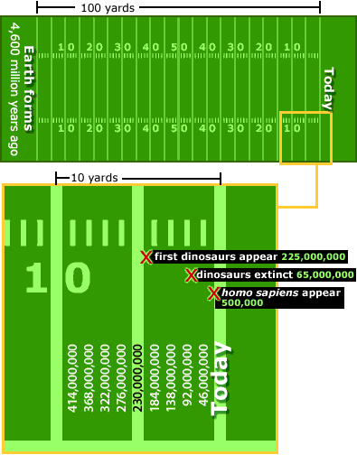
Geologic Time is very… very… very looooooong.
Earth is 4.6 billion years old or 4,600,000,000 years old.
If we made the Geologic Time Scale the length of a football field, dinosaurs would go extinct 1.4 yards from the end zone (the present).
Homo sapiens, modern humans, would appear less than 4 inches from the endzone!
Typically, major boundaries in Geologic Time represent major events in Earth’s history.
http://www.cotf.edu/ete/modules/msese/earthsysflr/time.html

Slide 3
Today we are in…
…the Phanerozoic
…the Cenozoic
…the Quaternary
…the Holocene
…the Anthropocene???
Major events in Earth history form the boundaries of the Geologic Time Scale.
More important events get higher ranks (Eon > Era > Period > Epoch > Age).
The Phanerozoic marks when there was a huge “explosion” of multi-cellular life. The Cenozoic began with the mass extinction of the dinosaurs. The Quaternary is the birth of the large polar ice sheets present today. And the Holocene began with the end of the last Ice Age.
Eon
Era
Period
Epoch
Age

Slide 4
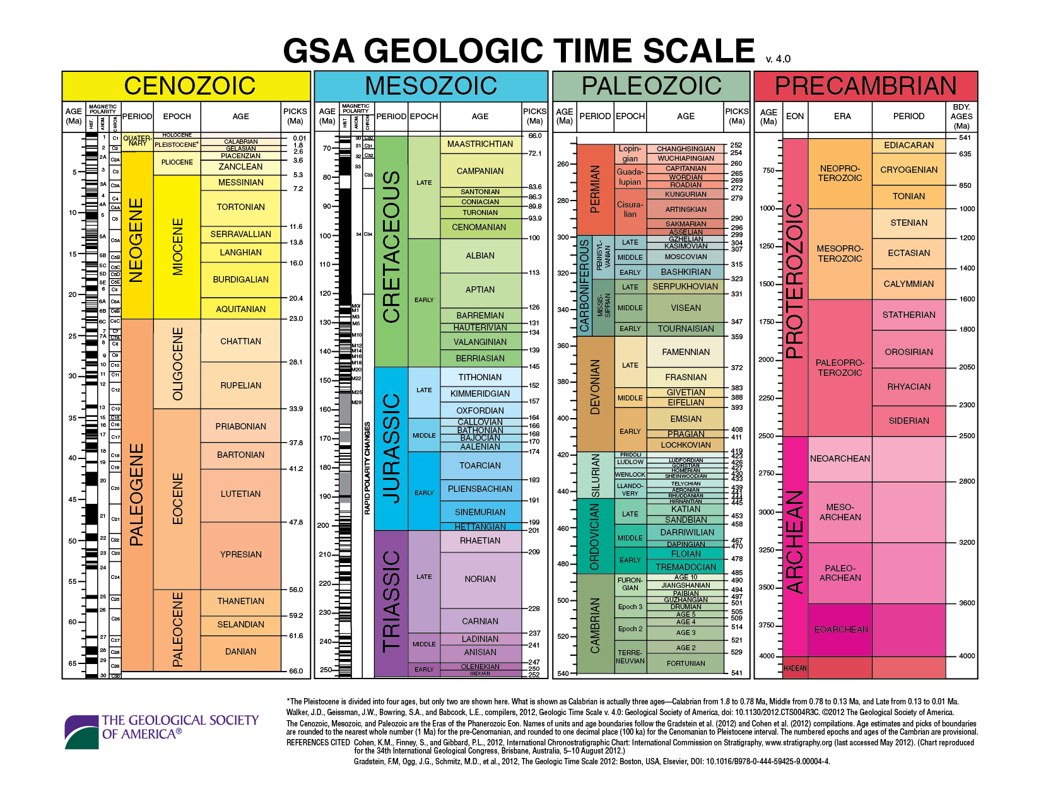
Holocene - 11,700 years ago – Ice Age ended, glaciers melted
Neogene – Quaternary
2.588 Million years
Glacial cycles began
“K-T boundary” –
66 Million years – Asteroid impact killed the dinosaurs
Permian – Triassic
252.17 Million years
Largest mass extinction/ Siberian flood basalts
Cambrian Explosion – 541 Million years – Life diversifies into complex organisms with “hard parts”
Hadean – Archean
4 Billion years ago
Late-Heavy Bombardment of Earth by asteroids;
Early plate tectonics began?
Early life began?
Stars mark boundaries between Epochs, Periods, and Eons that represent major events in Earth history.

Slide 5
Time for a new Epoch? New Age? – The Anthropocene?
Anthropo- = “human”, from Greek
-cene = “recent”, from Greek
It is only used as a suffix for Periods and Ages in the Cenozoic Era – the most recent geologic Era.
Humans have forever left their mark on Earth? Should we have a unit of Geologic Time named after us?
Now, we’ll split the class in half. Each side will be given a list of facts. You will debate whether or not the Anthropocene should be adopted.

