Slide 1
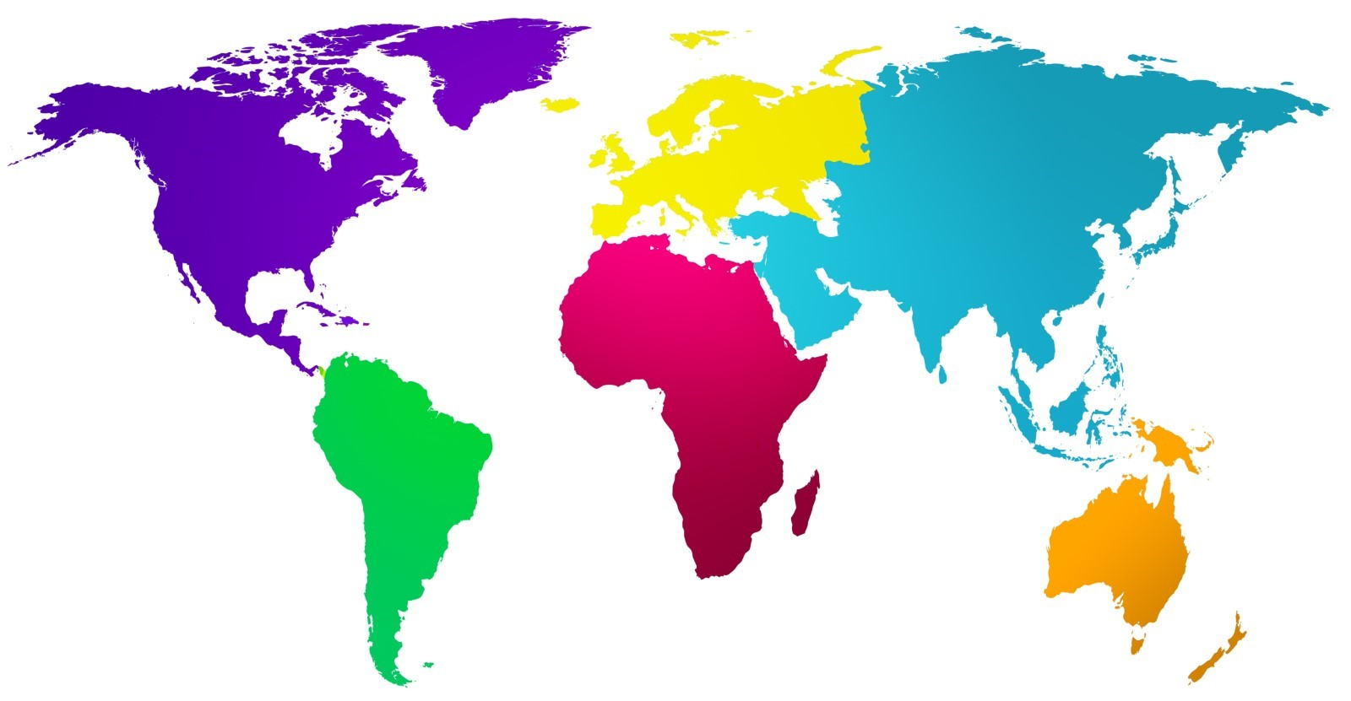
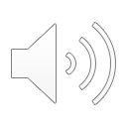
Antibacterials Around The World
Haily Showers
Ms. Smith
Microbiology
Penn State Schuylkill
Question: what are the most frequently used antibiotics medication around the world?
The most prevalent antibiotic is penicillin, which is generally amoxicillin. It is also considered to be one of the most potent. It is commonly used to treat diseases such as pneumonia, tonsillitis, and dental abscesses. The most common bacterial disorders treated with penicillin are strep throat and urinary tract infections.
UK
Amoxicillin: 7,874,302
Nitrofurantoin: 4,150,721
Flucloxacillin sodium: 3,754,633
Doxycycline hyclate: 2,962,900
Penicillin V: 1,834,967
Germany
Russia
Japan
Canada
Penicillin: 70%
Clindamycin: 26%
Aminopenicillins: 90%
Gentamicin: 30.1%
Ampicillin: 27.7%
Benzylpenicillin: 24.1%
Cefazolin: 8.4%
Cefazolin: 1446
Ceftriaxone: 3502
Ampicillin: 1500
Azithromycin: 1369
Ceftriaxone: 21.2%
Ciprofloxacin: 30.2%
Gentamicin: 8.8%
Asia
North America
Europe
USA
Spain
Korea
Antibiotic class: (millions) (1,000 persons rate)
Penicillin: 46.4, 140
Cephalosporins: 31. 4, 95
Macrolides: 29.9, 90
Tetracycline: 25.0, 75
B-Lactams: 22.6, 68
Amoxicillin: 51.1%
Clavulanic Acid: 45.8%
Clindamicym: 0.5%
Spiramicyn: 1.6%
China
Rank 1: 3rd generation cephalosporins, Ureido/carboxy-penicillin
Rank 2: Piperacillin/tazobactam, Ticarcillin/clavulanate, 4th generation cephalosporins, Anti-pseudomonal 3rd generation cephalosporins
Rank 3: Ertapenem, Imipenem, Meropenem, Doripenem
Penicillin (63.7%)
Cephalosporins (18.8%)
Africa
South America
Italy
Co-amoxiclav, amoxicillin, macrolides, and third generation cephalosporins accounted for 90% of all prescriptions.
India
Azithromycin: 22.4%
Linezolid: 66.7%
Cefixime-ofloxacin: 42.4%
Mexico
Penicillin: 51.87%
Cephalosporin: 8.79%
Quinolone: 7.69%
Macrolides: 6.59%
Folate synthesis inhibitors: 8.79%
Nitrofurans/Nitroimidazoles/Tetracycline: < 1.5%
Australia
Amoxicillin/clavulanic acid 28.6% (53 837)
Amoxicillin/azithromycin 9.8% (18 374) and 9.3% (17 519)
Cefpodoxime 6.7% (12 529)
Ciprofloxacin 8.5% (16 078)
Ceftriaxone 2.4% (4564)
Cefazolin (11.1%)
Ceftriaxone (9.1%) Metronidazole (6.5%)
Piperacillin–tazobactam (6.1%)
Amoxicillin–clavulanate (6.0%)
Notes:
Hello my name is haily showers and i am doing a research project on antibiotics around the world for Ms smiths microbebiology class. I decided to do this project on antibiotics since it intertwines with both my microbe class and my major in nursing. Antibiotics, as treatments for bacteria, have changed medicine since their first commercial use in the 1950s and helped to control many infections. Today, antibiotics have become common treatments for infections in the US and around the world. Unfortunately all antibiotics are not effective against every bacteria or infectious agent, which has led to their misuse and abuse over time. Even through the COVID-19 pandemic, antibiotics have frequently been prescribed in cases where they were not needed and has compromised antibiotic stewardship programs aimed at educating on their proper use. This literature review examined how antibiotics are being used around the world and aimed to explore differences in prescribed treatment associated with economic status. As you can see in the poster all the major countries have arrows from where they are located. Each country has thier own setts of anitbiotics along with the percentages of how constant those types of antibiotics are used. As you can see places with higher populations have an increased number of antibiotics, while smaller populations do not. Another aspect to look at is the countries themselves, for example Africa is a low income country with small percentages of antibiotics. People in Africa do not have the same resources as we do, so they have less medications but high health risks. Whereas China is a thriving country that has the highest population, the most finachel and the highest percent of antibiotics.

