Slide 1
How to Use the Check-In Kiosk
Student check-in view
How to view and pick a student up from the virtual waiting room and document attendance

Slide 2
How students check in at the kiosk

Slide 3
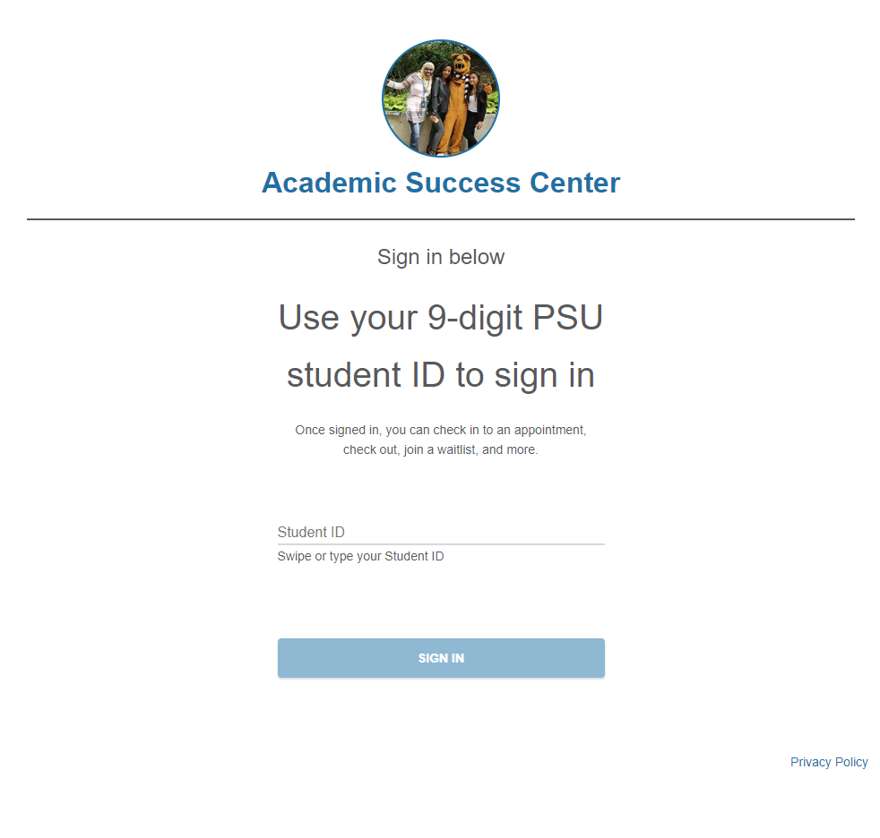
If you would like to use a check-in kiosk, work with the Starfish Admins to build the workflow that best meets your office needs
The kiosk can be used from any device that is connected to the internet and allows the student to input answers to the prompts
A card-swipe reader can be used to enter the 9-digit PSU ID
Student types or swipes to enter their 9-digit PSU student ID number
Student hits the Enter button of clicks SIGN IN

Slide 4
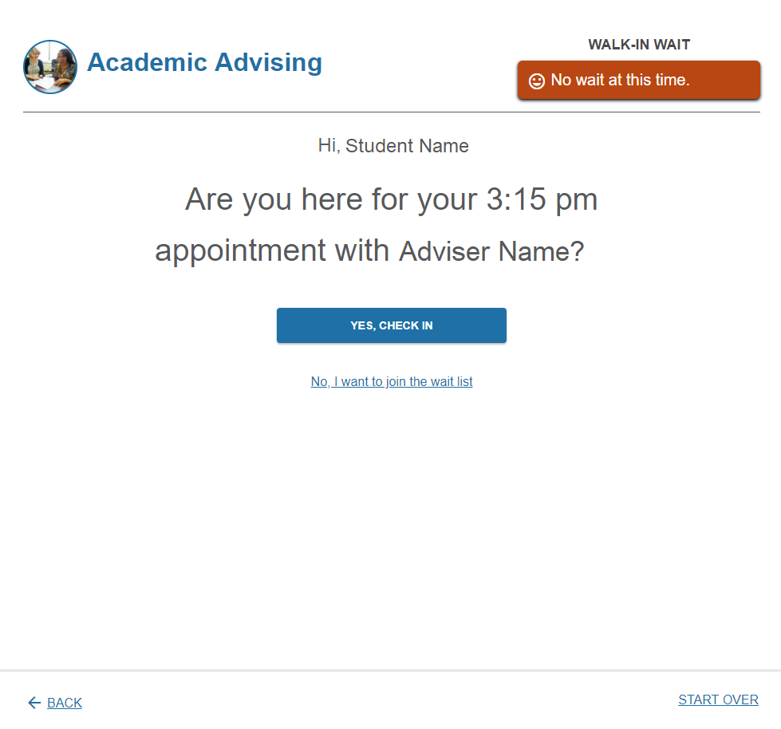
If the student has a scheduled appointment, the kiosk prompts confirmation
Student clicks to check in

Slide 5
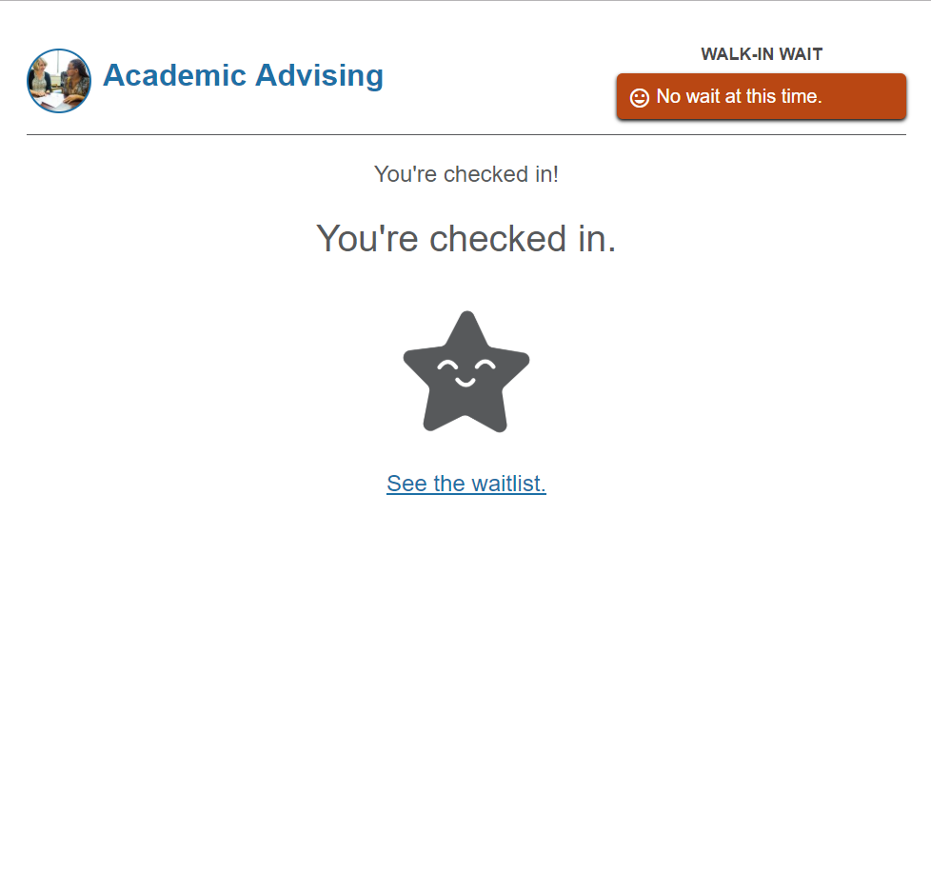
Check in is confirmed

Slide 6
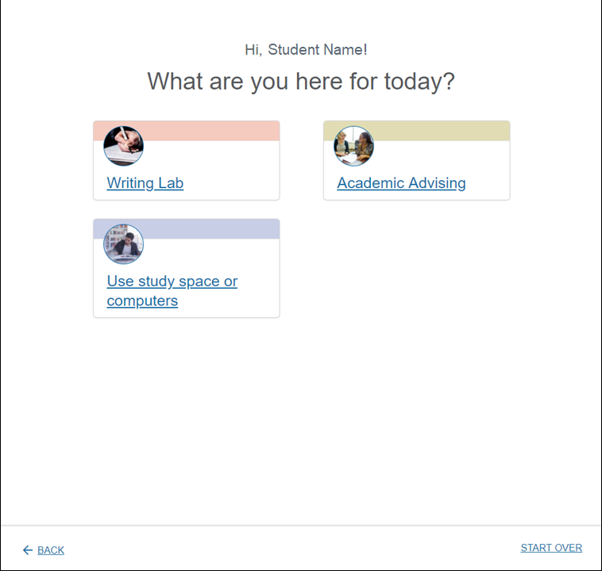
If the student does not have a scheduled appointment, the kiosk asks several questions, depending on your office’s workflow
If there are multiple services available to students through your kiosk, they will be asked to select one
If there is only a single service, students are sent straight to the next step
Student selects a service

Slide 7
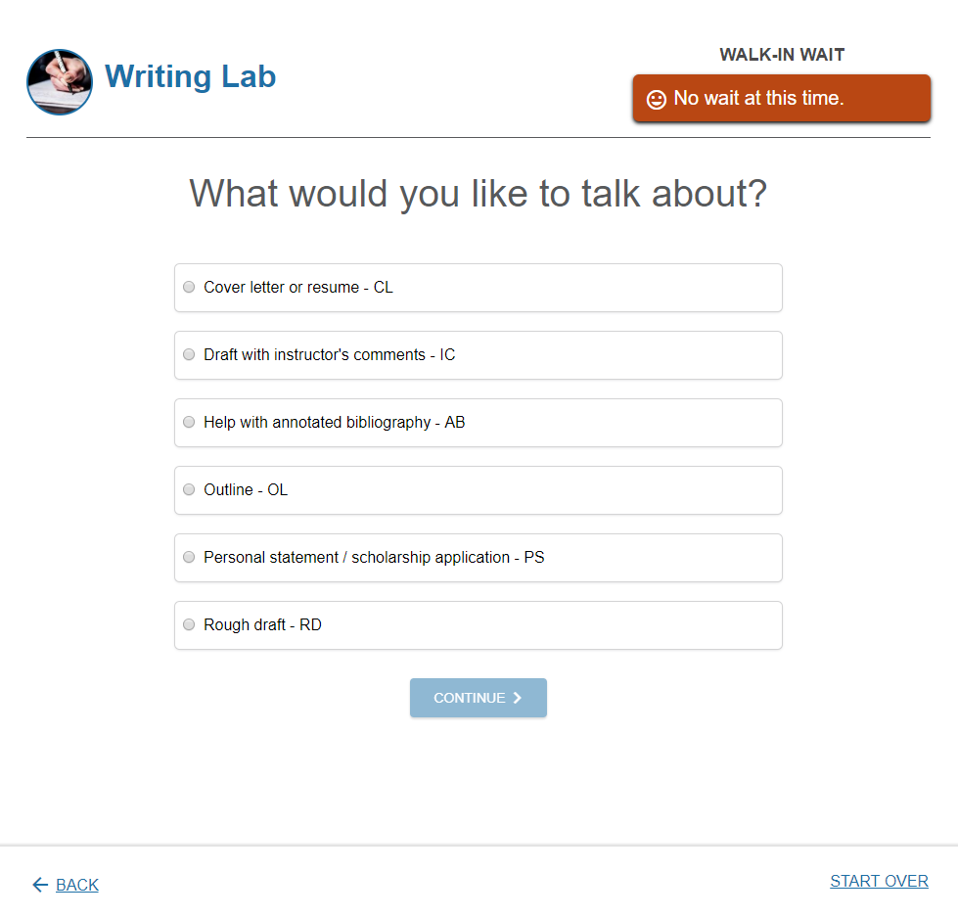
Reasons come from the appointment type associated with your service
Student selects a reason
Then clicks continue

Slide 8
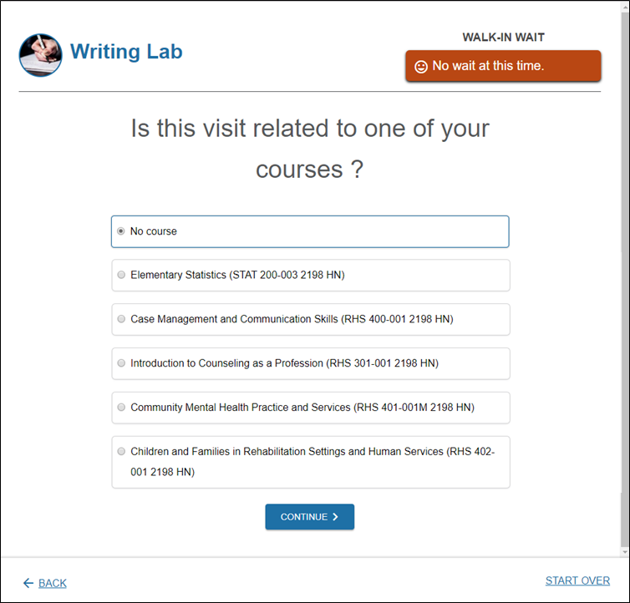
If the course is relevant for your workflow, students are asked to indicate if the visit is related to one of their courses
This list displays the student’s currently scheduled courses
Student selects a reason
Then clicks continue

Slide 9
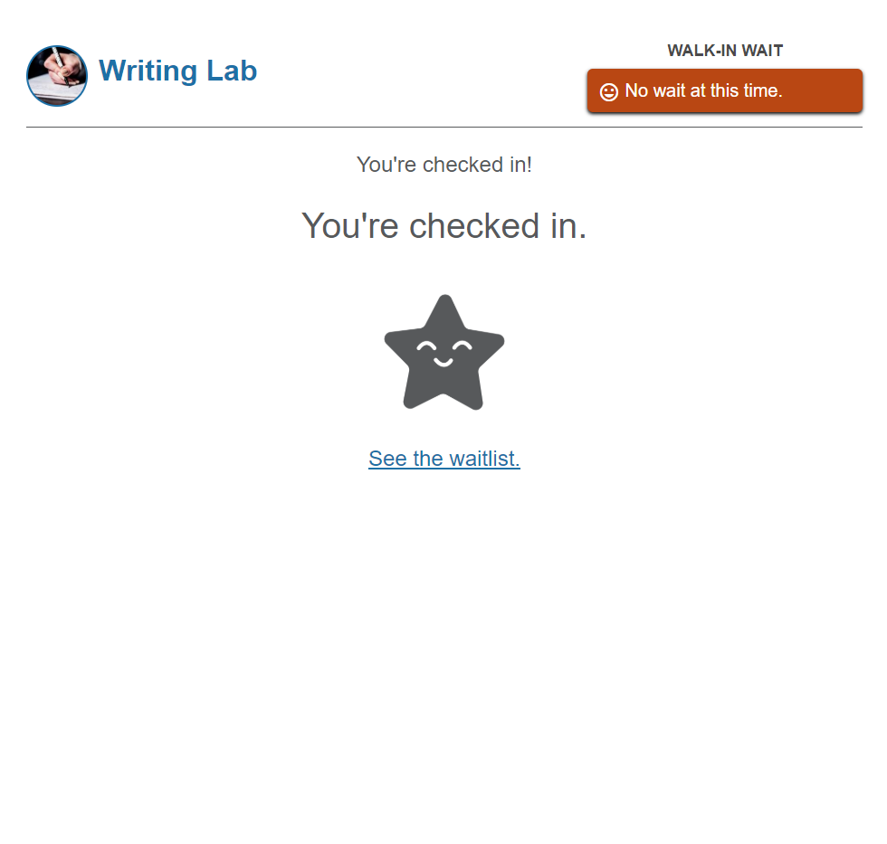
Check in is confirmed

Slide 10
How to view and pick a student up from the virtual waiting room and document attendance

Slide 11
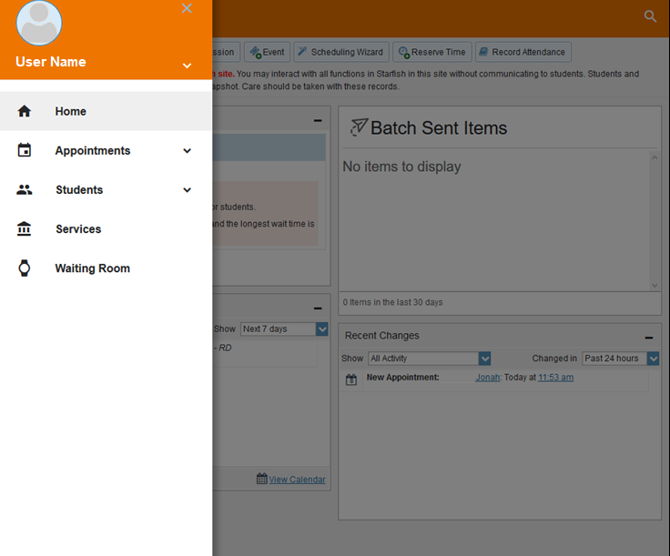
Open the Waiting Room

Slide 12
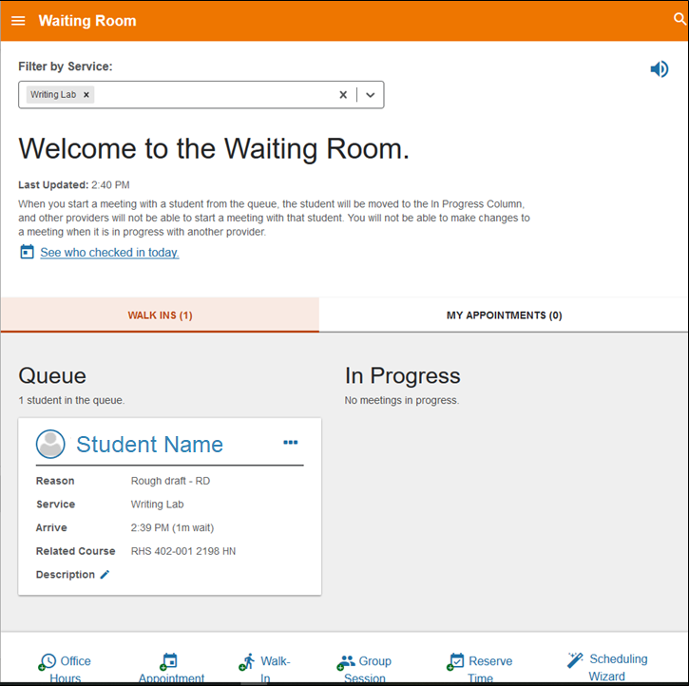
Toggle between drop-ins and your scheduled appointments by clicking the corresponding tab

Slide 13
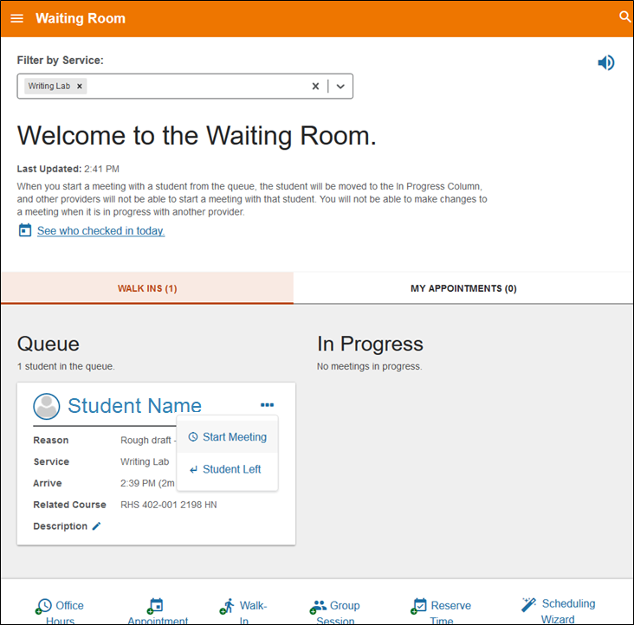
Click the … symbol, then select “Start Meeting”

Slide 14
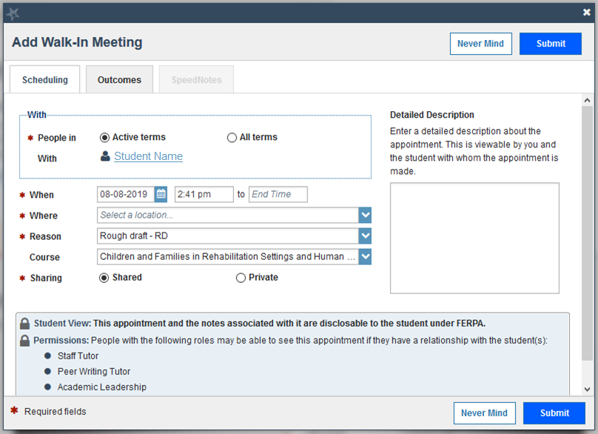
In most workflows, you will go receive the student and meet
During your meeting, you can view the student Starfish folder by clicking their name
When done, close the folder to return to this dialog box, which remains open in the background
Click the Outcomes tab
Select a location

Slide 15
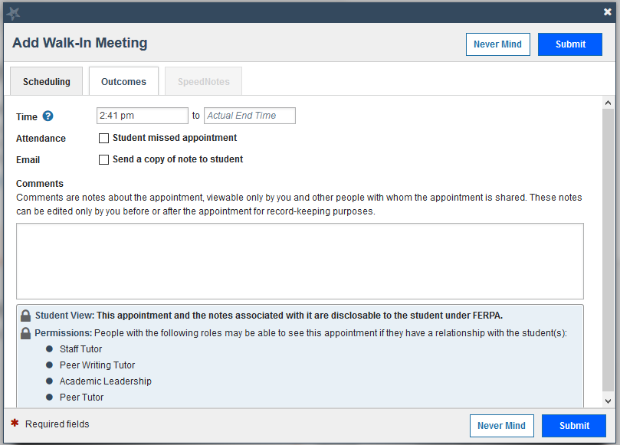
Click in the Actual End Time box to automatically enter the current time
Type comments
These comments are part of the student’s FERPA record
Note that you can see which other Starfish roles have permission to view your meeting and its associated comments
Click Submit

Slide 16
Additional help: starfish.psu.edu

